Slide 1
Natural Disaster’s Impact on Mental Health A Broader Perspective and primer
Abbey Strauss, MSW, MD
Boca Raton, Fl
Spring 2024

Slide 3
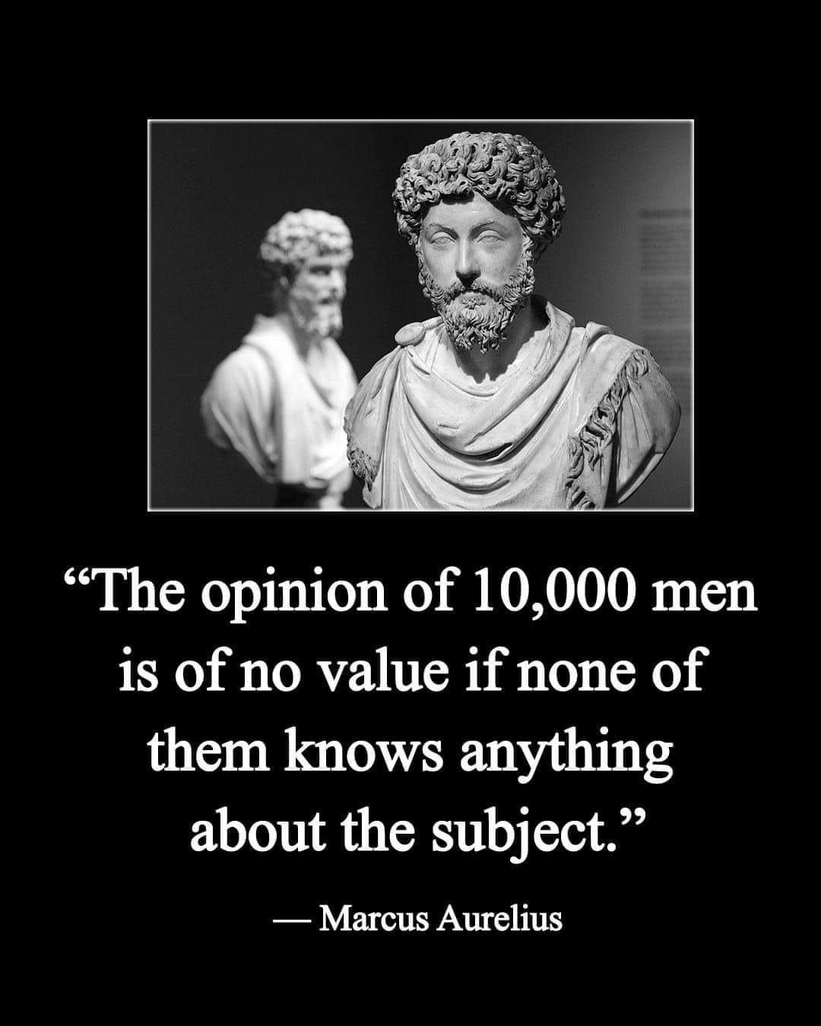
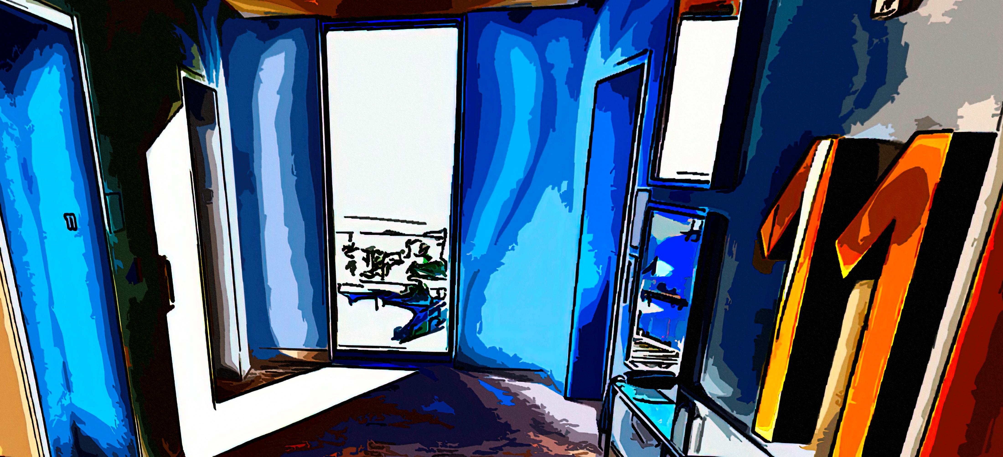

Slide 5
Opening caveats to ponder
All our food is wholly dead stars converted by sunlight
Look at your coffee: dead star water, add dead star or big bang atoms, with beans assembled by the photons qua photosynthesis in a fragile biosphere presently supporting this process
Nature is like physics – it has it’s own design, entropy and baseline. We currently benefit from that but its sustainability is not equal to our lifestyles and numbers.
Nature does not care about us the way we now must care about it.
It is easier and takes less time to destroy than fix.
Our time periods are a miniscule fraction of natures​ timetables.
Cleaning up Lake Erie was good but small. We cleaned up what we regionally did to it. That damage was not equal to global warming and planet tilt shifs, and did not also require worldwide consumption pattern changes.
Nature is indifferent to love, art, spirit, family, intuition, music and compassion. It is a 100% selfish survival. Life that we know found an unexpected and non-permanent nitch in nature. The origin and irrevocability of our life captures much opinion.
Our goal: keep nature able to support us. Nature will not change to accommodate us. That’s the ultimate mental health challenge.

Slide 6
Global warming – very abridged
The sun heats the earth. It lowers the entropy.
Life, via photosynthesis, converts some of the heat into CHO. This is stored as oil and life forms. That heat is then unavailable to be released back into space. Without life the earth would heat and cool at the same rate. Before humans, the earth has less heat to loose. A biosphere then evolved within the properly heated and cooled earth.
The biosphere survives in the temperature ratio of received heat, minus the converted and hoarded heat (as CHO), to the released heat.
Earth with pre-human life is cooler than with humans. In effect, biosphere global temperatures are lower because of less CO2 to block release heat to space. We today release CO2 from CHO stockpiles faster than the biosphere system can release heat into space.
It’s harder to then increase entropy, and so the biosphere warms and impedes its evolutionarily tuned survival tactics.
Some fluctuations can also occur from earth axis shifts.

Slide 7
The nitty-gritty
1. OUR CONSUMPTION PRODUCES WASTE PRODUCTS OR DEFORESTS FASTER THAN THE PLANET CAN PROCESS BACK INTO AN HEALTHER ENVIROMENT.
2. WASTE IS FROM BOTH FOSSIL FUEL AND OTHER ITEMS SUCH AS ANIMAL WASTES, AND CHEMICAL AND TOXIC DISCHARGES (WHICH CHANGE THE ECOSYSTEMS).
3. WE NEED TO CONSUME LESS AND REUSE MORE. OUR LIFESTYLES MUST CHANGE. CAN WE ADJUST FAST ENOUGH?
4. HOW DO MANAGE THE MENTAL HEALTH DISLOCATIONS STEMMING FROM FEARS AND ANXIETY OVER WHICH WE PROBABLY ARE NOT ABLE TO MODIFY INTO SAFETY?

Slide 8
Moving water’s location on the planet is inducing the planet’s axis shift
The Earth’s axis is changing. Earth’s axis started shifting drastically in 1995, moving the the poles and changing its direction.
The operative agent are the melting glaciers and ground water pumping.
Melting glaciers do more than raise sea levels. They alter salinity, currents, and water temperatures. This can then vary the seasons.
This shift is related to the re-distribution of spinning earth’s weight and mass.

Slide 9
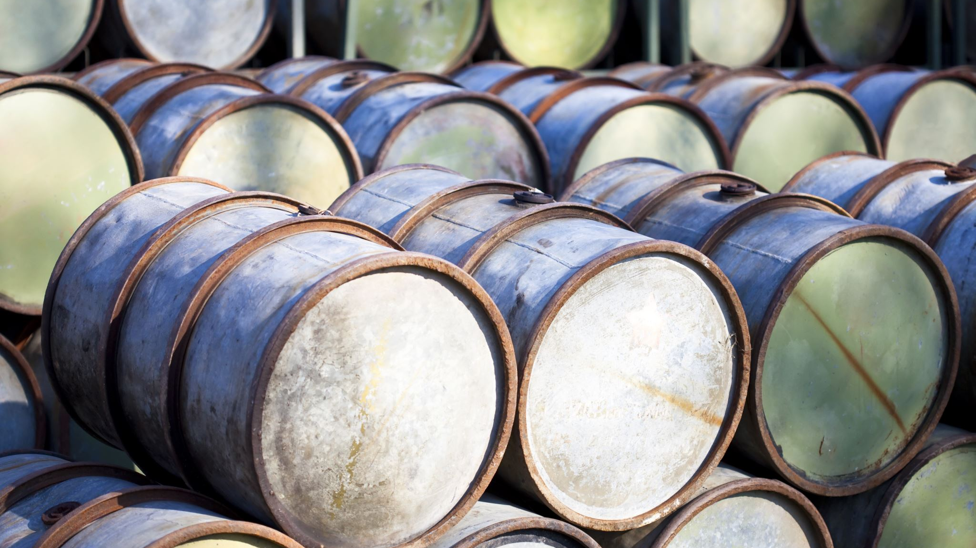
Crude Oil into gasoline – core information
One barrel of crude oil is 42 gallons. It has has 5,684,000 BTU.
1 gallon of crude oil therefore is 135,333 BTU
1 gallon of finished motor gasoline is equal to 120,214 BTU
124,262 BTU from crude oil is needed to produce 1 gallon of gasoline.
It takes 135,333 BTU to distill and get 1 gallon motor petrol product of 120,214 BTU.
1.125 gallons of crude makes 1 gallon of usable motor gasoline. Other products come from that same heat.
A car with 40 mpg, so the cost to the earth’s supply of crude oil is actually only getting 32 mpg. This formula does not include the amount of gasoline used to transport the crude and finished products. From eia.gov

Slide 10
Troubling questions sure to be asked
Someone asks: “but, but… what if we run out of oil, what are we going to do? When will that happen? How can I maintain this lifestyle without this energy and material to maintain and enhance my life?”
The Millennium Alliance for Humanity and the Biosphere at Stanford University (MAHB) paints the picture that the world’s oil reserves will run out by 2052, natural gas by 2060 and coal by 2090. When Fossil Fuels Run Out, What Then? - MAHB (stanford.edu)
Other estimates give approx. 60 more years before depletion.
Think about the fact that a 5-year-old will face a ‘no more oil’ in their life.
Can science and society meet this challenge and really reform our lifestyles in 25-50 years?
If we do slow or stop earth warming, how long will it take to cool the earth enough to go back what is good for us?

Slide 12
Oil consumption – it goes up
Year Millions of Barrels
2026 97.1
2020 91.2 Reduction from less use secondary to Covid
2021 97.1
2022 99.6
2023 101.9

Slide 13
Timeframe for Natural Replenishment
Creating oil is a very inefficient geological process. Estimates are that 2,500 metric tons of organic material – mostly phytoplankton – will form just one barrel of crude.
The thought is it would take 750 years of all the oceans’ phytoplankton production to make the oil currently consumed in a single year.

Slide 14
As of feb 14, 2024

Slide 16
Another global warming consequence
Researches conclude that climate change could disturb nuclear waste left in Greenland and the Marshall Islands. “Rising sea levels could spread contamination….”
In Greenland, chemical pollution and radioactive liquid are frozen in ice sheets, left over from a nuclear power plant on a U.S. military research base where scientists studied the potential to install nuclear missiles.
Grist.org, Feb 28, 2024

Slide 17
SPEAKING OF Consuming and lifestyles -
Think of doing psychotherapy about climate change while drinking from a Starbucks cup. It is paper with an inner plastic polymer coating to keep liquid out of the paper. The industry depends on these throw away cups. Plastic grocery bags generally are not recyclable.
0.9 kg crude oil needed to make 1 liter gasoline (1 liter = 0.75 kg)
900 million barrels per year makes 260 million tons of plastic
Recycle with incineration or landfill leave toxic residues.
Recycle chemically – two processes claim few toxic residue – 1 kg plastic gives ~ 1 liter oil
Thermoplastics can be re-melted recycled. Thermoset plastics have an irreversible chemical bond and cannot be remelted into new material. They are non-recyclable.
USA disposes ~50 million tons of plastic per year, only 4% is physically recycled, and not all that is reclaimable.
Wish-cycling – “I recycle which makes me feel good.” But the plastics may not be recyclable.

Slide 18
Can hydrogen replace fossil fuel? Is it as clean as advertised?
Burning hydrogen doesn’t produce CO2 when burned. It yields water. Hence ‘clean’
Global Warning Potential of hydrogen is 11 times greater than CO2.
Hydrogen increases ozone and radiative forcing effect, hence higher temperatures.
Hydrogen extends the life of methane. Hydroxyl radials interact with hydrogen instead and don’t reduce the methane levels.
Hydrogen leakage is common and called fugitive emissions.
How can we produce enough and safely use hydrogen to reduce oil use within 50 yrs?
How much energy is needed to produce hydrogen?

Slide 19
psychotherapy outline
Cause – immediate and future
Effects – immediate and future
Interventions are to what endpoint?
Is the endpoint achievable?
Is the endpoint not achievable?
How much are we treating and how much are we teaching?
Treating ‘heat events’ is needed but only equal to re-treating the same wounds. Will these invoke larger corrective actions?

Slide 20
Some clicking points – a rest stop for our trip
The usual formats of psychotherapy is sufficient as long as it is recognized now as having a different therapeutic endpoint – that the core contributor is not escapable or fixable. Resiliency and subsistence needs inconvenience and personal change.
Treatment demands some world-wide life-style changes that will be troublesome. “Ok, my part is tiny, albeit it is important.”
Going green is perhaps still too faddish, that it helps only a little, but it is a start. Again, is it too much ‘wish-cycling’?
The feared endpoint is an increase in world temperature of 1.5° C by 2030. (Some estimates up to 2050.) But how and can we re-cool the earth to safe levels in our lifetime? Doubt.
The challenge is largely the global population size and our consumption patterns. These behaviors apply to us as well – which is a bite we all need to take. What have you done to change?

Slide 21
270,000,000 YEARS AGO

Slide 22
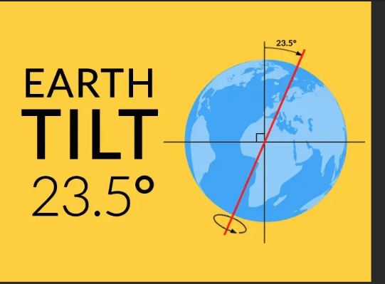

Slide 23
The tilt’s origin and a call to impermanence
Something hit Earth and knocked it off-kilter. That changed the rotation axis tilt. Our current biosphere expects that tilt.
The item that hit is called Theia. It also blasted a immense hole in the surface which sent dust and rubble into orbit, which scientists think became our Moon.
Note - Jan 2024 – a football stadium sized asteroid (# Potentially Hazardous 2008 OS7) passed just 2.2 million miles from the earth.
What Causes the Seasons? | NASA Space Place – NASA Science for Kids

Slide 26
Water storage shifts on earth
Rapid terrestrial water storage (TWS) decline caused by ice melting over glacial areas drove the polar drift toward the east in the 1990s
Since 1980, the Earth’s north and south poles have drifted approximately 13 feet due to changes in the planet’s weight distribution caused by melting ice.
Normal earth shifts occur every 41,000 years (Milankovitch cycles). This seems to be faster.
Too little shifting for impact during our lifetimes? But think of long term.
Earth's spin, tilt and orbit - Understanding Global Change (berkeley.edu)

Slide 27
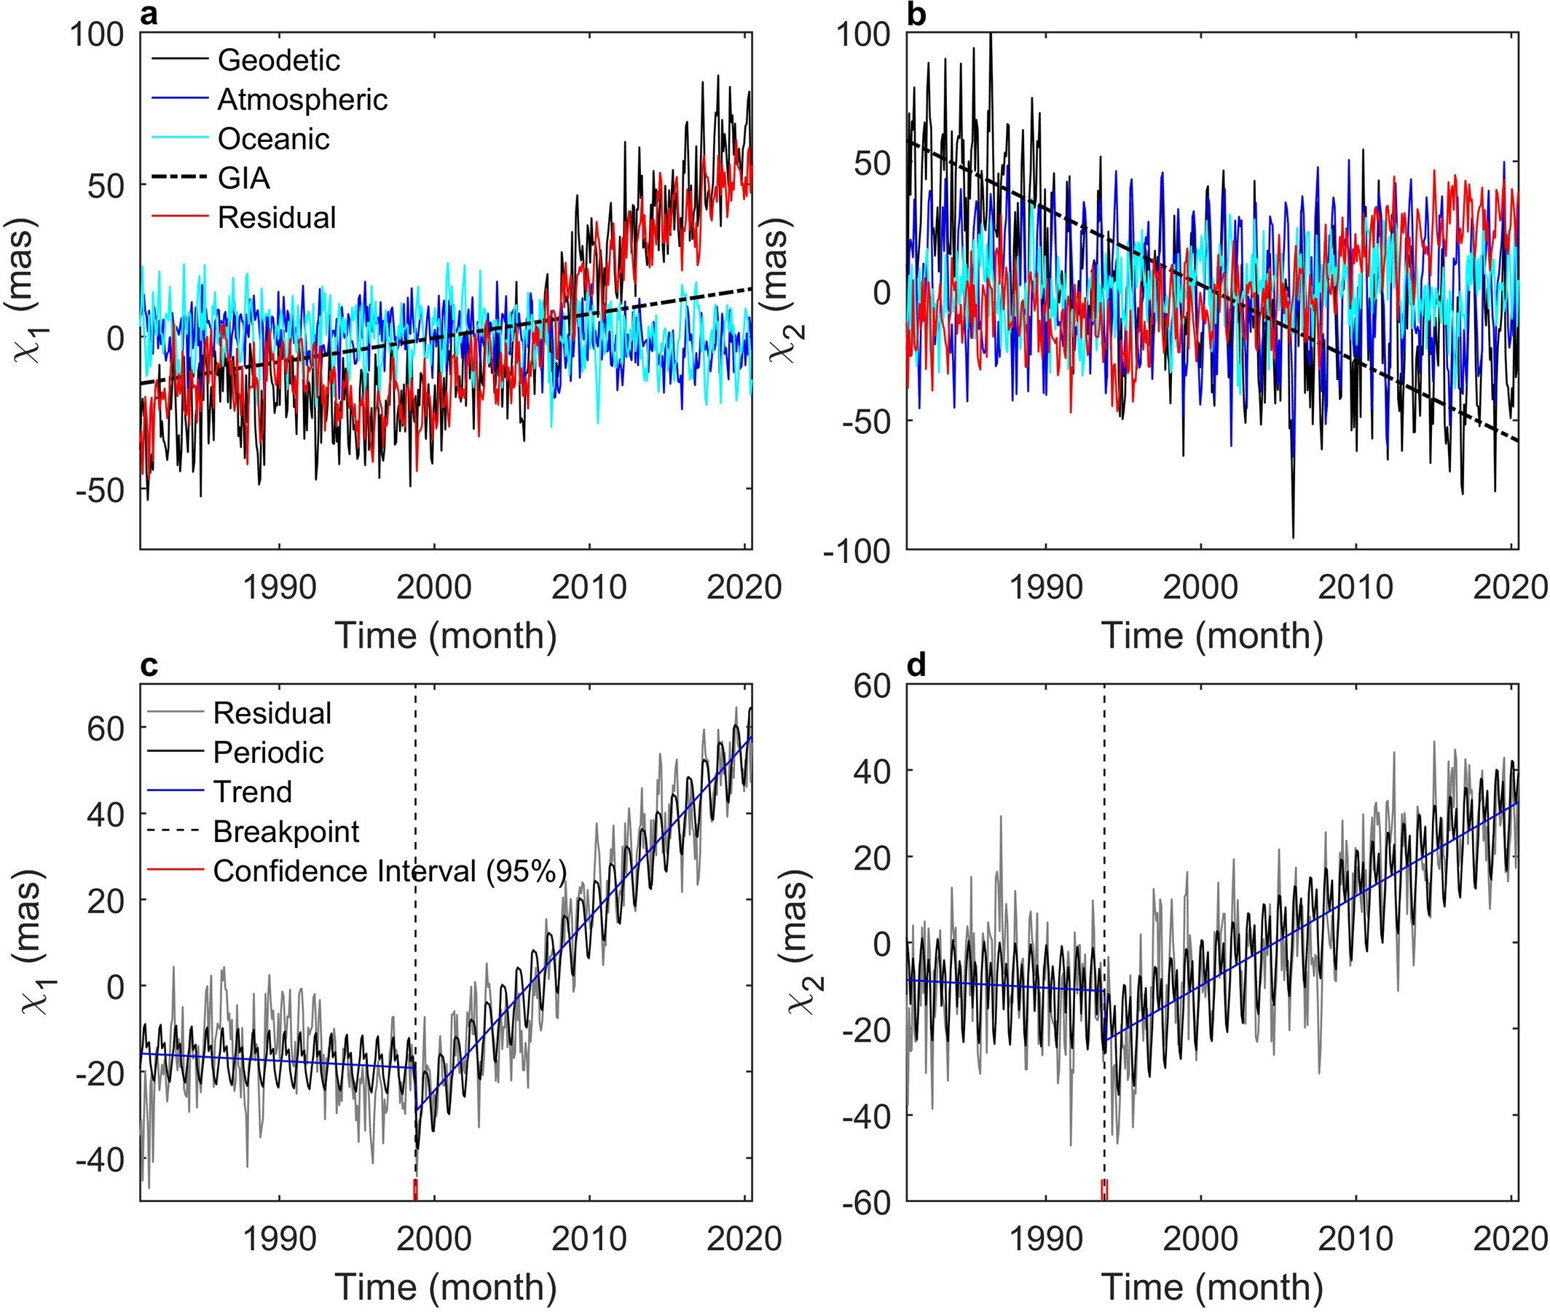
Polar Drift in the 1990s Explained by Terrestrial Water Storage Changes
Geophysical Research Letters, Volume: 48, Issue: 7, First published: 22 March 2021, DOI: (10.1029/2020GL092114)
Notes:
BFAST‐detected polar drift in the 1990s from January 1981 to June 2020. (a and b) show the monthly time series of the geodetic excitation, the geophysical excitations, and their residuals for χ1 and χ2, respectively. (c and d) are the breakpoint detection results of the residual using BFAST for χ1 and χ2, respectively. BFAST, Breaks for Additive Season and Trend.
IF THIS IMAGE HAS BEEN PROVIDED BY OR IS OWNED BY A THIRD PARTY, AS INDICATED IN THE CAPTION LINE, THEN FURTHER PERMISSION MAY BE NEEDED BEFORE ANY FURTHER USE. PLEASE CONTACT WILEY'S PERMISSIONS DEPARTMENT ON PERMISSIONS@WILEY.COM OR USE THE RIGHTSLINK SERVICE BY CLICKING ON THE 'REQUEST PERMISSIONS' LINK ACCOMPANYING THIS ARTICLE. WILEY OR AUTHOR OWNED IMAGES MAY BE USED FOR NON-COMMERCIAL PURPOSES, SUBJECT TO PROPER CITATION OF THE ARTICLE, AUTHOR, AND PUBLISHER.

Slide 28
Water and the earths tilt
2150 gigatons of groundwater estimated were pumped between 1993 and 2010, and the redistribution of that water weight to the world’s oceans has caused Earth’s poles to shift nearly 80 centimeters during that time. In fact, groundwater removal appears to have played a bigger role in that period than the release of meltwater from ice. Coming from Northern areas changed mass redistribution more than from closer to the equator pumping places. June 2023
Humanity’s groundwater pumping has altered Earth’s tilt | Science | AAAS

Slide 29
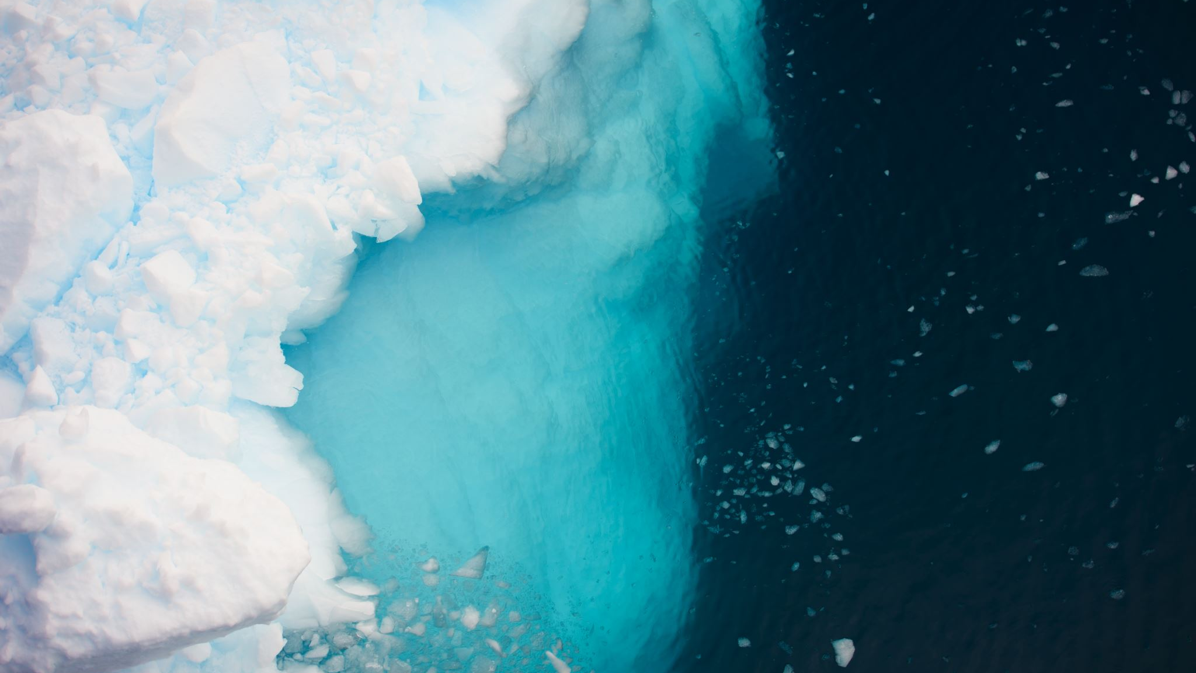
How long will it take
To refreeze the water into ice to return to the former mass distribution, if we can even move the new recycled ice mass?
The goal is two-fold:
To slow or stop global warming.
To allow time for global cooling. But will it reset the global tilt for seasons we are used to?

Slide 30
The precautionary principle
Be safer than sorry
Sometimes seasoned intuition is best

Slide 31
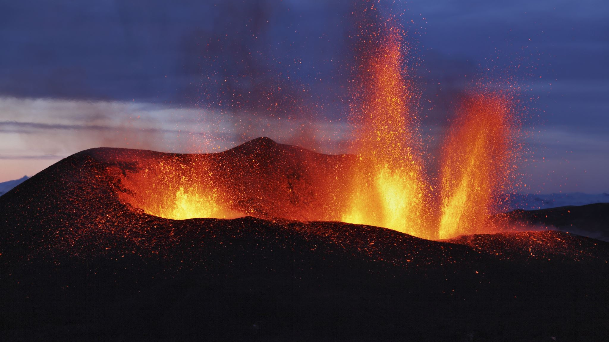
Disasters Have Changed. They Need Different Mental Health Strategies.
The previously all natural disasters of tornadoes, storms, droughts, some forest fires, and avalanches are now goaded by climate change. Earthquakes and volcanoes are not.
The psychosocial impacts were once from pure chance events. Not now.
Future disasters – sea levels, pollutions, water and food sources, are unhurriedly caused by climate change. They will come.
Do we treat the event’s impact or the cause? Or both?
If yes, how to do so?

Slide 32
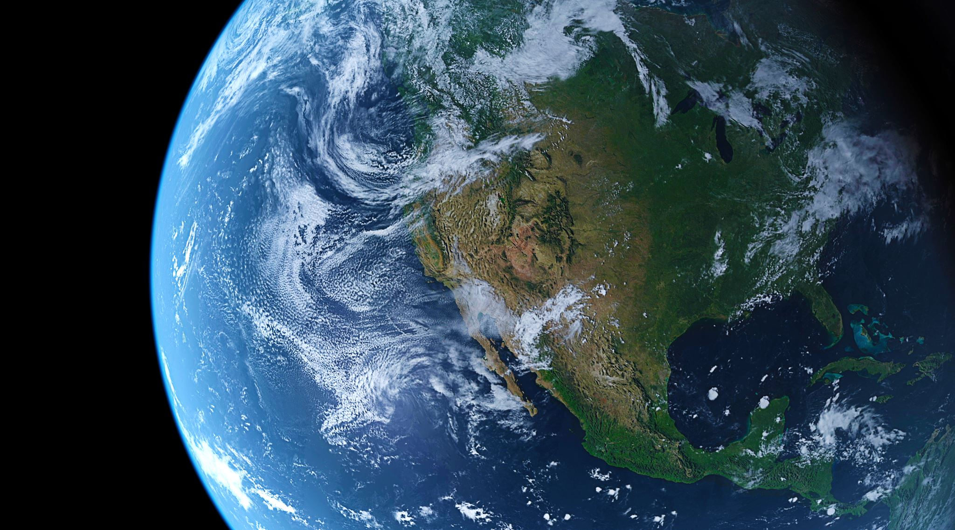
More Concerns Inside any Therapy
That politics and other countries make things worse is problematic. “Do they not care about me, and apparently for themselves as well?”
Storm disasters. These prompt political and economic questions: how to move to avoid them, and how to rebuild. Who pays for it?
Some insidious climate prompted disasters will come. How do we prepare for the need to move elsewhere to live after the event? Who will pay for it?
Prepare for realizations.

Slide 33
Climate – The Word
Climacteric, from the Greek word klimaktēr, for "critical point" or, literally, "rung of a ladder." It is used for inevitable times on the metaphorical ladder of life. Today, climacteric refers to male andropause or female menopause, with a "turning point leading to an end of something." I was taught the term referenced the male process only.
Historians want to pinpoint the Roman Empire's climacteric, when it began its downhill slide. When is/was/will be ours?
Apocalyptic is its common synonym. The first known use of climate to reference weather was in 1578, somewhat related to latitudes.
Climate used to mean the trend or inclination of weather in a specific region; now it is the full globe. This brings us all together.

Slide 34
Terms And Concepts
Solastalgia – emotional pain from environmental changes
Climatoxins* -- the major one is our current lifestyles
Eco-resiliency -- the needed endpoint
Eco-security -- not possible
Eco-depression, grief, anxiety, etc. -- reactive and anticipatory
Inescapable and Inevitable Events – they cannot be dismissed or sidestepped, temperature, sea levels, etc
Ennui – Weariness, quiet sluggishness, hopelessness, more personal than community wide.
Nihilism – Pessimism and destruction, turmoil.
Anomie – expecting something that will not occur
Regional and Global Changes – Some are avoidable and some unavoidable, water wars (Kenya), food, land, farm management, other social changes, dystophia

Slide 35
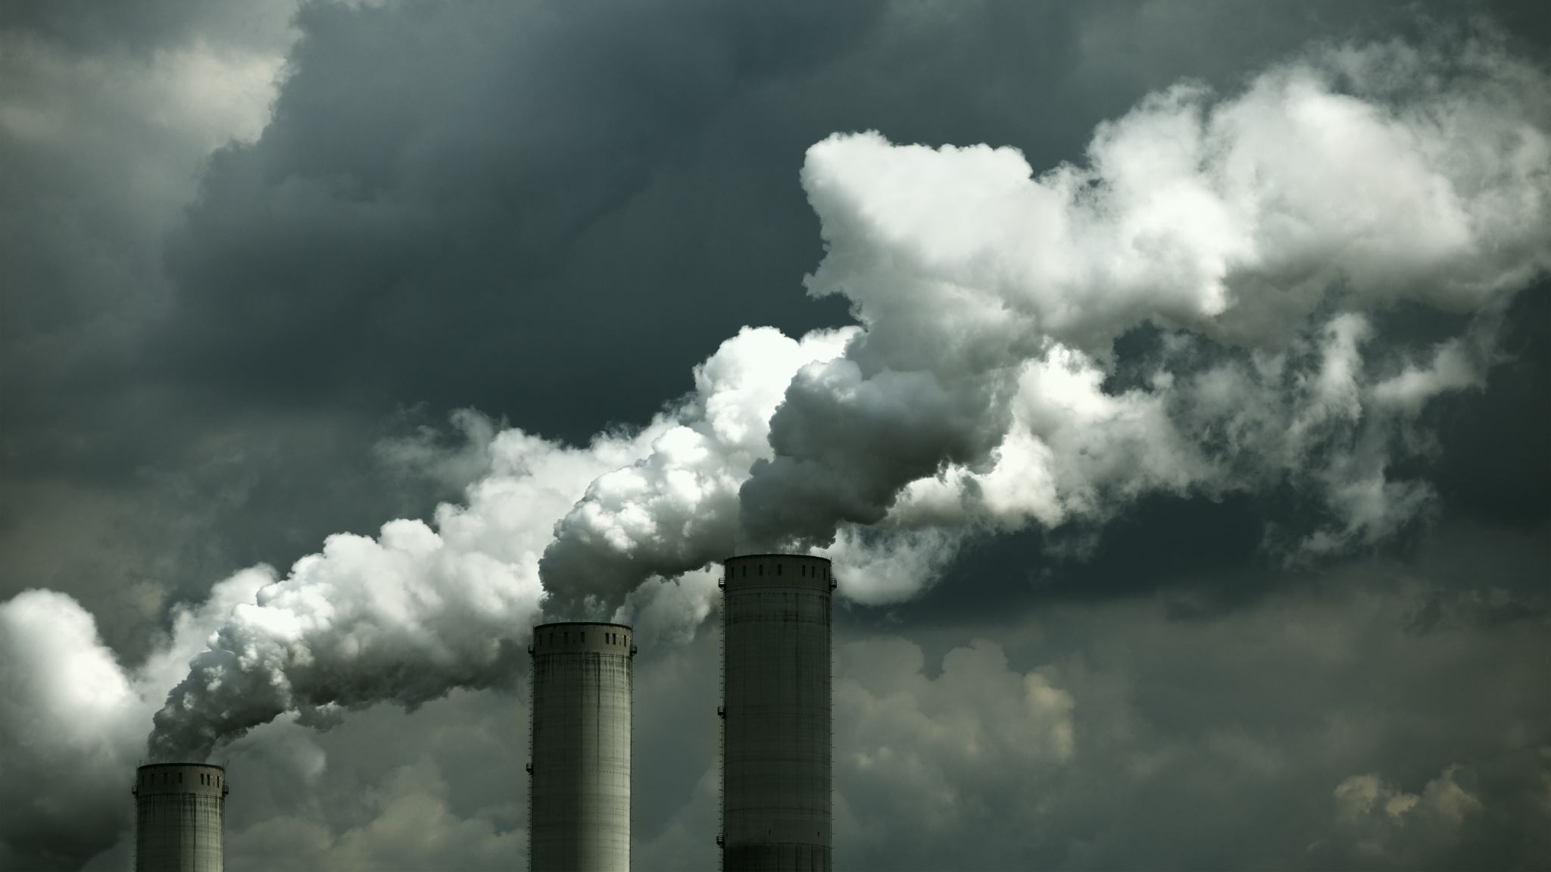
Solastalgia
Coined in 2005 by Glenn Albrecht.
From Latin sōlācium (comfort) and the Greek root -algia (pain, suffering, grief) -- emotional or existential distress caused by environmental changes.

Slide 36
anomie
Emile Durkheim, in 1897, in his book Suicide, used the term to reflect the malady of the infinite, because it was a desire without limit that can never be fulfilled; it only becomes more intense. He also called it an insatiable will.
Will climate change result in a social uprooting and dissolution of moral and other societal systems if the climate changes become too pressing?
Do we have a desire and expectation, without limit, of what the earth can and will do for us?

Slide 37
Psychotherapy Approaches
Usual psychotherapy techniques suffice if it is recognized as having a different endpoint – that the external core contributor is not escapable or fixable. Change “what you can, but prepare for more.” Which ‘therapeutic marketing flags’ are waved? Will they just kick the can?
Treatment demands world-wide life-style changes. Beginning anything therefore requires that we cast a spell allowing the hard challenges in front of us not to become stagnation by frustration. To begin demands we break old patterns and reconfigure ourselves. This needs to be done by mixing our courage, tenderness, our psychosocial activities, a sense of our achievable power, and a sense of our vulnerability. It is not easy.
Remember that much of our life is really shaped more by how things end rather than how they start.

Slide 38
even we here today not are helping – hang on!
Ultimately, if we reduce the population and our consumption patterns, then the climate changes on our planet will again become those caused by nature, and not us. Tremendous time and self-discipline will be needed, but even with massively effective efforts, it may be too late for our generation to benefit. The grasp of this is penetrating.
Equally, the existential panic of realizing that not everybody is helping to make our planet sustainable can be overwhelming and defeating.
How to therapeutically manage that? Do we engender sacrifice, hedonisn, altruism, insight, social activism, etc? Your designs, please.
The alcoholic stops his own drinking, the abused spouse separates, we quit the bad job, etc. We can’t get away from even our own cars and plastic, let alone that in the rest of the world.

Slide 39
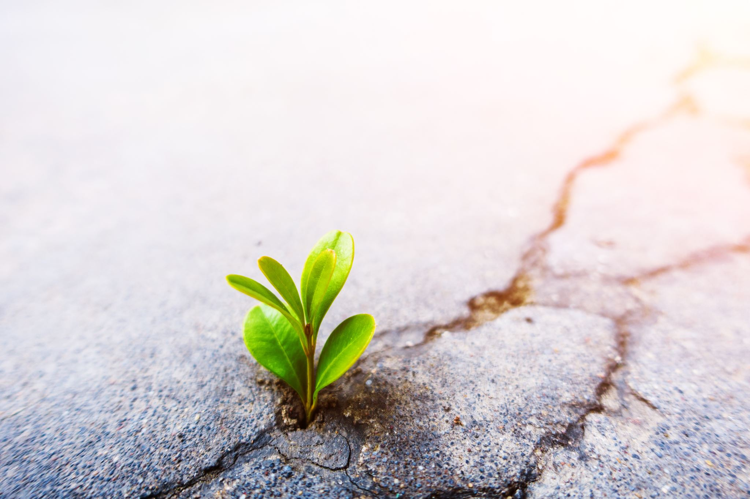
Ecocide – Killing The Ecosystem
Are we the enemies of our own survival? Storms which used to be purely natural are now worsened by climate change.
Therefore, the syllogism exists of we being our own enemies. Do we have the right to demand nature be forced into a type of slavery for us to maintain an uninhibited consumptive short run, and that neither we nor nature will survive this ‘run’ of consumption patterns.
Ecuador has declared that the planet has legal rights of protection. Should trees have equal legal rights? They are living entities, as we are, but we don't seem to really care enough about them.

Slide 40
Ecocide Background
Ecocide -- fro the Greek oikos for home, and Latin cadere, for kill.
It is described as the unlawful or wanton acts committed with knowledge that there is a substantial likelihood of severe and either widespread or long-term damage to the environment being caused by these acts.
Ecocide has been stopped by law in many countries, including the EU.
It can refer to both peacetime and war occurance if there is a destruction of the environment. Stalin did it to Ukraine in the 1930’s.

Slide 41
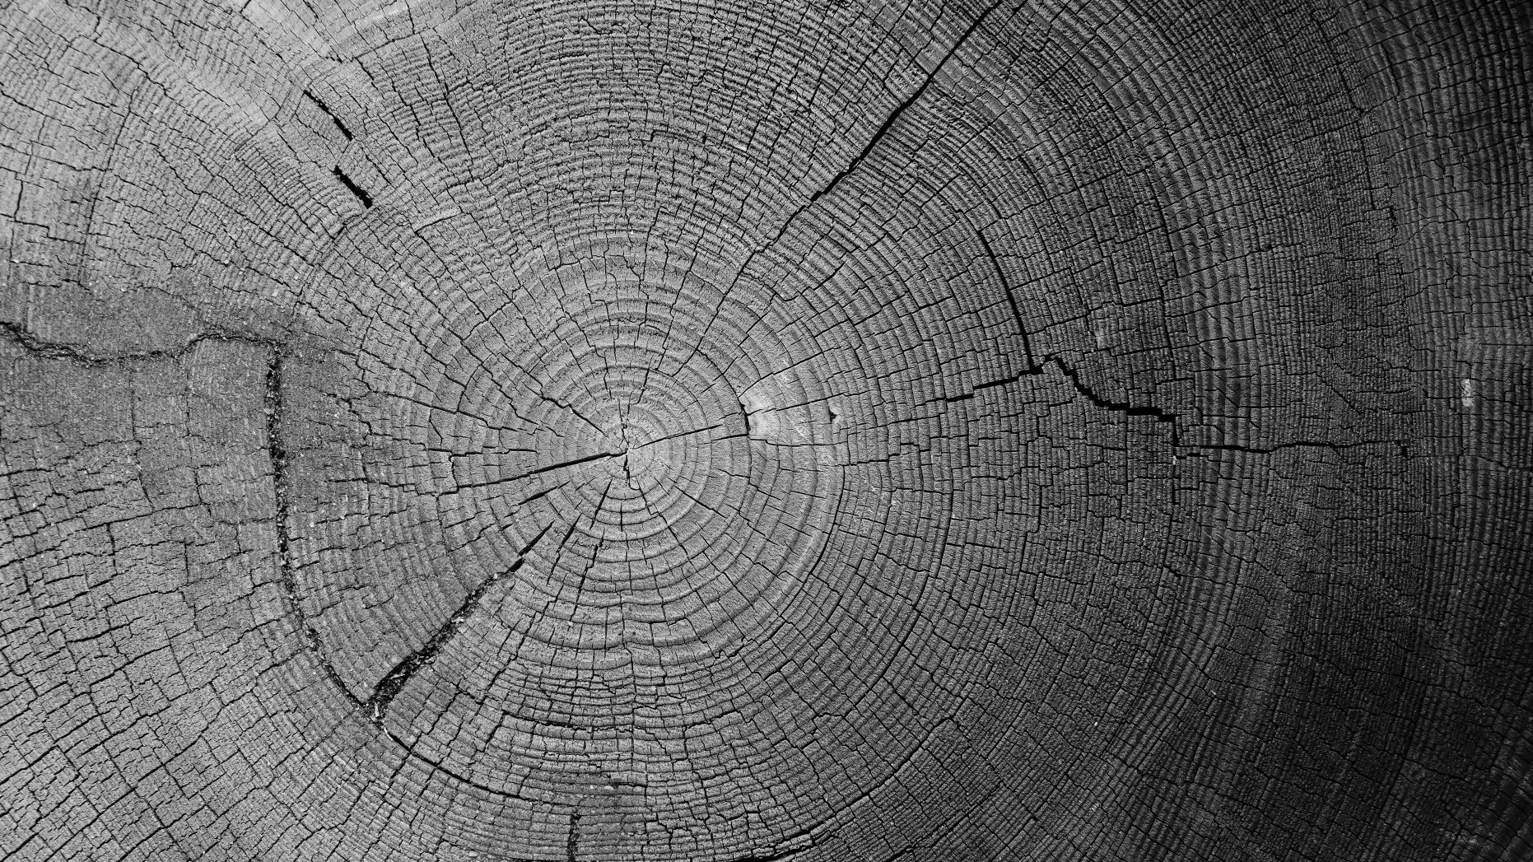
The reality of our cultures
We must accept the reality of our cultures. We must not sidestep the bite-our-lips reality that technologically we do not yet know how to rapidly enough repair the Earth's climate illness.
What will be the postmortem explanation of this climate disease? What will be the real diagnosis? “Dishonored and defeated by the occupant’s life-styles?”
We must not just prevent and treat diseases of the individual, but also of the biosphere.
We are like the rings in a tree.

Slide 42
The Zeitgeist Of Our Times
A zeitgeist is the general intellectual, moral, and cultural climate of an era. It is also considered to be an invisible agent or force, a spirit, that characterizes a given epoch. Philosophers see it being currently used, somewhat colloquially, as a system of fashions, fads, or social architectures.
What zeitgeist will be in history’s descriptions of this part of our existences? Will there even be someone to record history?
Our psycho-climate challenge parallels our fight against obesity. It takes discipline, time, and inconvenience to eat healthier in order to lose weight. It takes the same philosophy to address climate change. We cannot slip into a parallel of Ozempic-like tools for climate control.
Which leads directly to what we, as mental health treaters, are being asked to treat versus what we need to treat.
Which returns us to the Zeitgeist.

Slide 43
The Emotional Response Starts
Like war zones, many of these battles have yet come to our hard homes. The ratio of watching to feeling the changes is still more watching.
When a natural disaster hits our home and lifestyle, it can cause an intense emotional back-lash. “The hurricane was worse because the ocean was warmer, and our house went under water! I didn’t realize that two degrees made such a difference, and the ocean is so big, how can this happen to it, and then to us? And now you tell me more like this is to come?”
An indirect natural disaster hit can have an equal response. “I grow apples, and climate change reduced the bee population, and we ended with up fewer apples and I’m losing money…”

Slide 44
Human stirred disasters – they don’t ‘come and go.’ They ‘stay’
Sea rise and losses of places to live
Ocean temperature rising, changing ocean current events
Sea water going into fresh water
Acidification of the oceans
Plankton blooms and oxygen dead zones
New agricultural patterns, growing seasons, & bee populations, etc.
Longer, more intense heat events with all its implication
Sewage and pesticide run offs, carbon sinks, methane rise
Deforestation
Our Fuel Consuming Life-styles and Population Growth

Slide 45
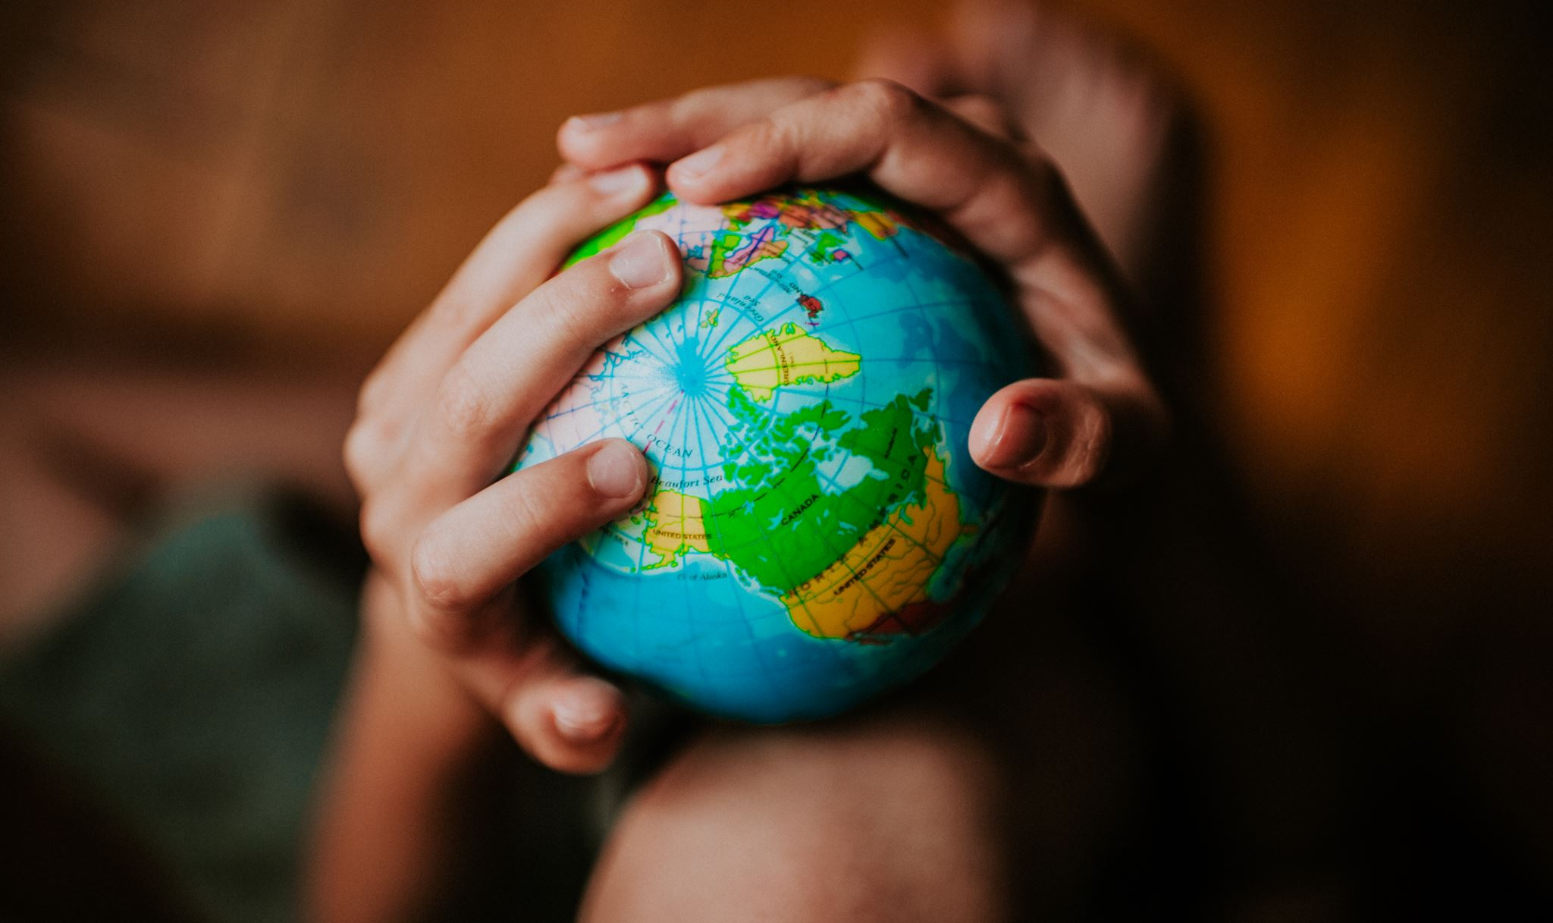
Caveats on Mental Health Interventions
Our psyches live in the same biosphere as our bodies.
Teaching about heat events requires nothing new other than doing it a bit more rigorously. We should have done this all along. Its just that the heat is worse, more people live in hard to cool places, there are more heat incidents, the population is older, and the heat durations are longer. And for many, the intervention is to use more air-conditioning. is underpowered or not available!
Teaching ourselves, and our patients, how to plan for climate related events is critical, but it must be done without panic, even as we tell them it may only get worse. “Doc, I’m afraid of the future.”

Slide 46
Define the challenges
Carefully define the challenges, and then offer skills accordingly.
Some skills will be to modify the amendable provincial challenges, and some will be on how to live with unmodifiable challenges.

Slide 47
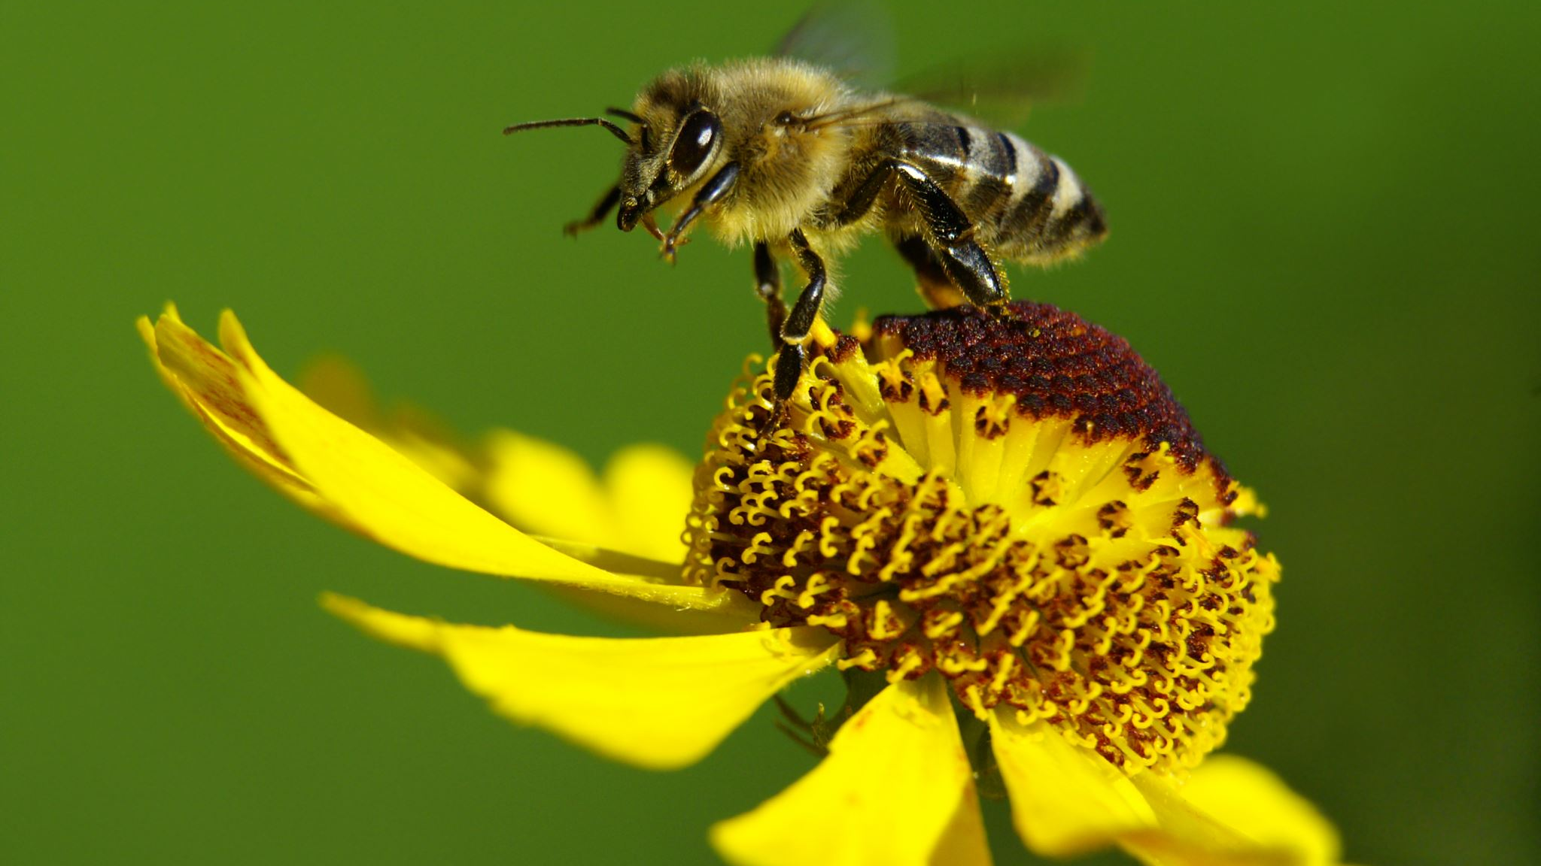
Climate Change, The Bees, The Flowers, Our Food, Our Emotions, Our Resiliency
Bees depend on scents to search for plant nectar, which is their food. Floral scents are unique to each flower and plant. Bees have a special ability to remember these scents in their search for pollen. Climate change has resulted in plants changing their scents because they are climate stressed. As a result, it is difficult for bees to find plants for food, leading to the loss of bee population.
Timing is crucial for pollination, as flowering and hatching must coincide for successful pollination to take place. Climate change has resulted in the mismatch between the period when flowers produce pollen and when the bees are ready to feed on the pollen—decreasing seed production and causing food shortages.
National Pollinator Week: The Climate Threat to Bees | Department of Energy

Slide 48
More caveats about managing the feelings
Two themes may arise - a fear that it is too much out of control, and so too late, and so a great anger that more was not done beforehand.
Prepare for ennui, nihilism, egocentrism, fatalism, hedonism, religious passion and appetite, persevering denials, and solastalgia.
Meter the intervention capacities of the ego. Treatment may need a hard focus on what they productively need do to help themselves and the community today and ‘tomorrow’. They may feel overwhelmed. Something this big is new.
Inquire where they get nontoxic information about climate change.
Treatment requires screening for thought disorders, minor cognitive impairments, age, cultural backgrounds, education, psychsocial history, etc.
Remember we are talking about the survival of our biosphere beyond our lifetimes, and those who ‘now and will’ live within it. That may be too much for some people to consider.

Slide 49
Outlining Caveats….
A purely natural disaster, such as a tornado, can be used for the context that the world normally has such events. If natural events cause panic, then a deeper level of developing endurance skills first needs to be addressed. Blending in climate change may at first be too overwhelming.
The therapist needs to be endlessly aware that climate change emotional distress has a different existential endpoint. It is learning to live with an unsolvable problem, and yes, we will have to make many life-style changes. The earth will ultimately win, but we do not necessarily have to lose. And straight science may not be able to rescue us in a fast enough manner.

Slide 50
if the earth is not predictable and safe the way I expect it to be… what happens to us?
Basic pre-treatment questions we must ask ourselves:
Are we bringing too much existentialism into the therapy mode? Can patients handle it? Can we handle it?
Is unlabeled climate change induced existentialism by itself infiltrating into the psyches in manners we are not prepared to treat?
The world maybe permanent for our life spans, but not more. This uncertain mutability may be unnerving to many; how might this be discussed, and even prepared for, for all of us?
Are we misleading if we do not bring in the existential ticket?
How do my ego strengths compare to other peoples’ ego strengths?

Slide 51
What Are Our Goals As We Prepare To Treat Others
What is the origin of the anxiety? What is the treatment endpoint?
Are we treating to lower the triggers or to lessen the responses?
When and if should medications be used for this type of mental ailment?
What treatment model should be used – CBT, DBT, EMDR, insight psychotherapy, pastoral, resilience training, desensitization, anger management?
Can we introduce reality and still avoid panic?
Consider comorbid issues – egocentrism, personality issues, fragile egos, substance abuse, OCD, immaturity, real financial or job issues, religious issues, denial, thought disorders, etc.
How to handle those who have deeper existential fears?

Slide 52
What is In The News?
Arsht-Rock (climateresolve.org) is deploying impactful and sustainable solutions by putting policy into action and paving the way for new climate resilience finance and innovative insurance approaches for people, cities, and countries.
Climate-aware therapists are trained to look for signs of climate-based distress and anxiety and help their patients become more resilient. (verywellhealth.com)
The APA Committee on Climate Change and Mental Health is identifying the key components of curricula on climate-related issues. (Psychiatric News, APA, May 25, 2022)

Slide 53
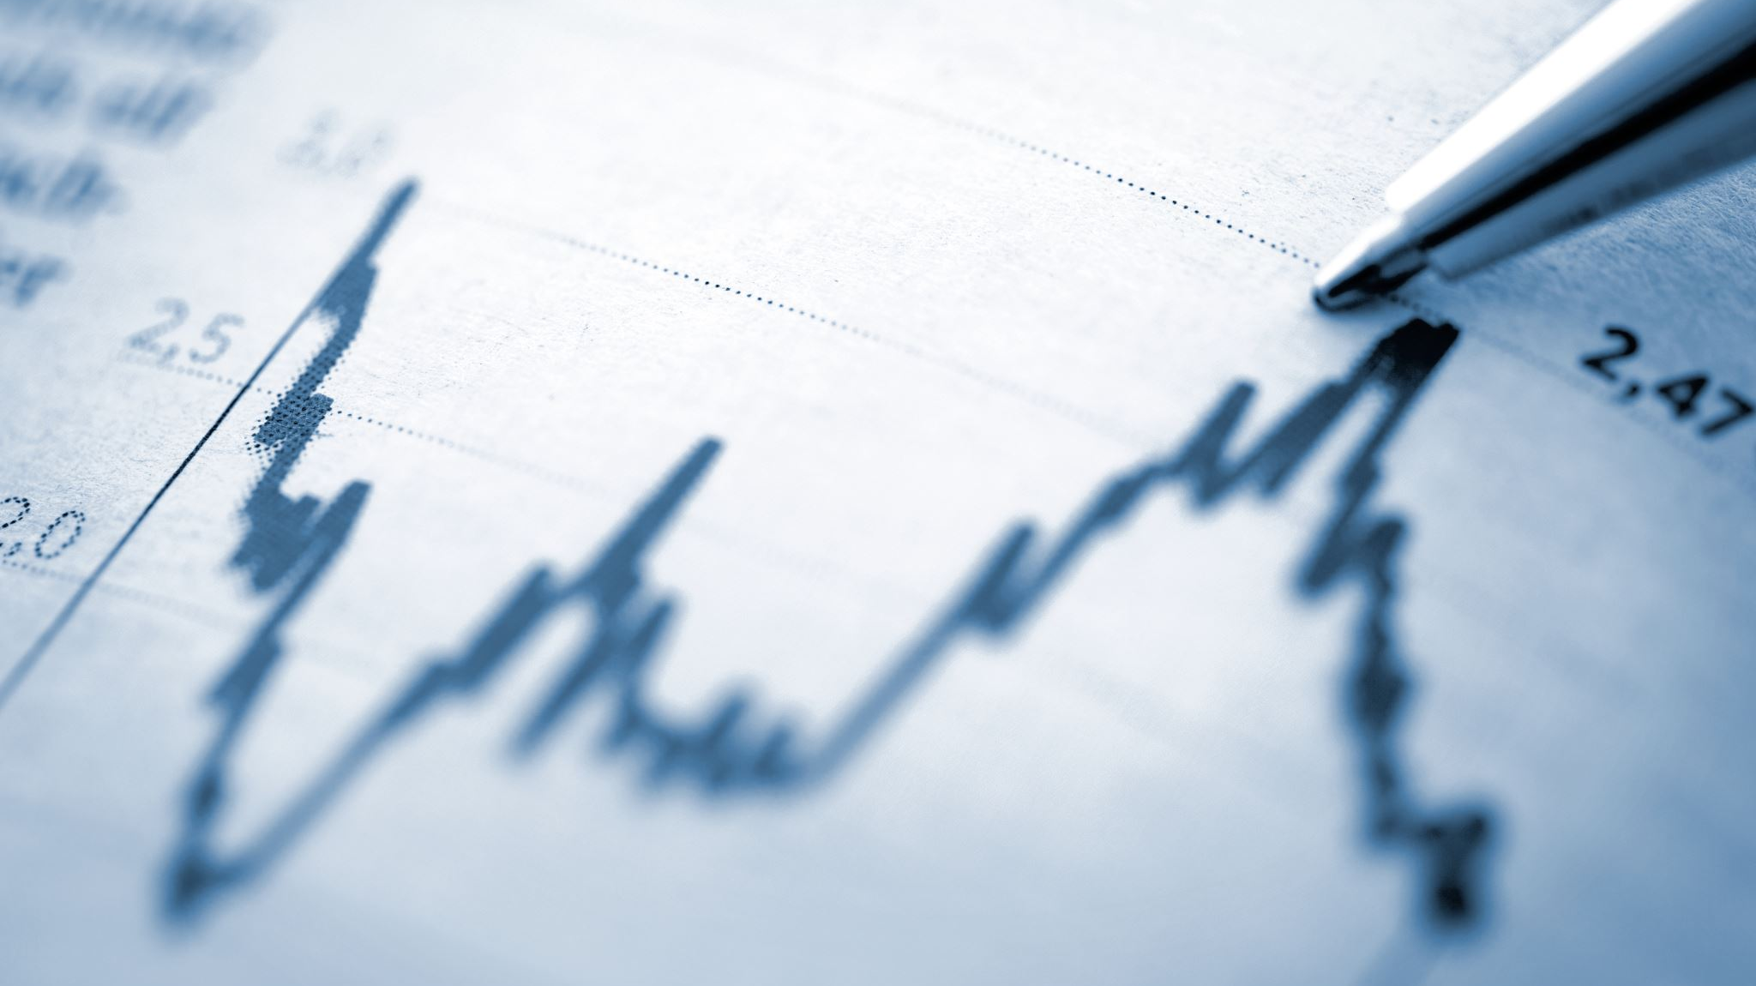
The real endpoint
The European climate agency Copernicus said the year (2023) was 1.48 degrees Celsius (2.66 degrees Fahrenheit) above pre-industrial times. That’s barely below the 1.5 degrees Celsius limit that the world hoped to stay within in the 2015 Paris climate accord to avoid the most severe effects of warming. (AP. Jan 9, 2024)
What would it take to cool the earth back to a ‘safe level’? Stopping temperature rises may be the wrong end point. This is key!
James Hansen, whose testimony to the US Senate in 1988 is cited as the first high-profile revelation of global heating, that the world was moving towards a “new climate frontier,” with temperatures higher than at any point over the past million years, bringing impacts such as stronger storms, heatwaves, and droughts.

Slide 54
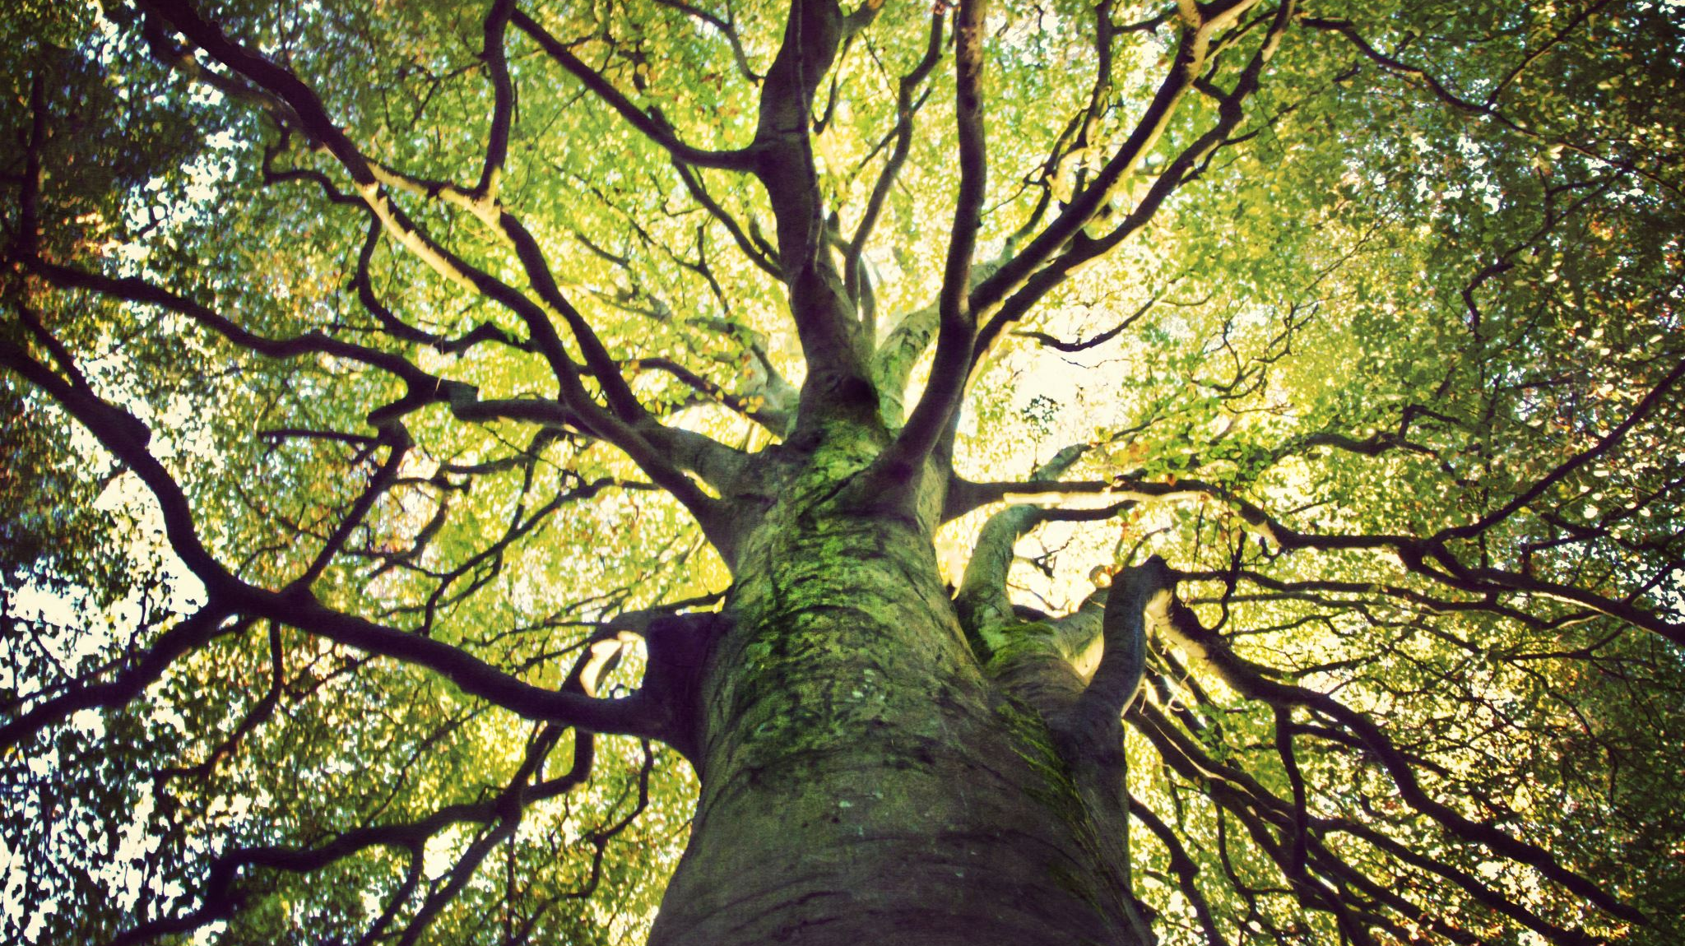
A few thoughts
For years, those making climate change warnings were ridiculed and called tree huggers, killjoys, spoilsports, pessimists, weak worry warts, anti-growth, etc.
Frame this denial in egocentric terms.
The three common steps to advancement – the real de facto ‘scientific method’ –
That’s impossible, wrong, or crazy.
Then, well, ok, maybe that might make sense.
Finally, but of course, it’s so oblivious…why did we miss it?

Slide 55
The Hockey Stick and global warming story, since 1200 AD.
Michael Mann, a professor of climate science at the University of Pennsylvania, first published a graph in 1998 Nature that was dubbed the “hockey stick” for its dramatic illustration of a warming planet. He was maligned and attacked for this by conservative writers, alleging his work was fraudulent and that he tortured and molested data. They compared his science and depictions of global warming to the same as a convicted child molester.
But a jury on Thursday (Feb 8, 2024) awarded him $1 million for defamation after he sued the writers.
His work was exonerated.

Slide 56
The 1999 mann graph – the hockey stick, back to 1200 ad

Slide 57
From NASA – 1000 years

Slide 59
Temperature Baselines
The year 2022 was the sixth warmest year since global records began in 1880 at 0.86°C (1.55°F) above the 20th century average of 13.9°C (57.0°F).
What happened in 1980?

Slide 60
1880-2021 Warming trends - NASA

Slide 61
As of January 11, 2024 --

Slide 62
Do We Treat The All-Natural Vs Mixed Caused Disaster With A Different Focus?
Yes Those former distinctions may no longer exist.
How much do we educate and treat about the future versus immediate post-disaster symptom – wherein rests the larger worry?
How much existentialism do we need to bring into the treatment?
Should we begin with an etiology distinction – is it all natural or contaminated?
Or how do we respond to this: “I don’t care about the future, just make me less anxious.”
What happens if we learn there is anger at the loss of normal and expected life choices?
Let’s stop and have some discussion of these as starting points

Slide 63
The deeper questions…
What are our expectations of earth’s workload ability? Are we finally living the results of exhausting its resiliency? Can the earth support both our population and our expectations to support our needs and pleasures?
Do we have to wait for the earth to recycle itself? Will a few years of living a greener life, and with better carbon or other sinks, produce that different of a end product?
Are we working to maintain a new lifestyle, or are we trying to re-achieve the older and less climate change compulsory lifestyles modifications?
The question “Wait! I studied this and it is bigger than I thought. Can you truly help?”
The answer “Not that easily. But let’s find a path in a mult-realm strategy.”
The ennui factor: “are we too late? Or is the best we can do is to maybe slow it up a little?”

Slide 64
Some basics we are expected to know
Back to basic science We too often treat the symptoms more than the origin – this takes away from our treatment depths and effectiveness. We need hard knowledge of:
Psychological basic science and theory, as well as the theories of therapy types, i.e., which ones do we use with this clinical challenge?
Biological basic science – what, how, and why is the climate changing
Be aware of socio-religion-economics-political sciences. Patients hear what is not being done. How do we deal with their reactions to that? And the entire sociology of the Thorstein Veblen’s notion of a leisure class, wasteful capitalism and the ensuing lifestyle, evolutionary economics, etc.
Look at ourselves. how much of what we say to patients have we done ourselves? What are we being true to if we waste gas? Or leave the lights on, etc. Have we changed behaviors before we ‘treat’ others to do so? What do we really believe?

Slide 65
Avoiding Rube Goldberg Models & Pitfalls
A "machine“ (or treatment model) is often presented on paper that would be impossible to implement in actuality.
Many therapy models exist. Some of them may be Goldberg machines when dealing with climate change.
One universal impediment is when too much confidence rests that legislation will repair or prevent, even if it is often possible to implement.
The Goldberg model is prevented when people make real personal changes. The healthy tsunami builds from the bottom up and not the top down, though it helps if the top executes the same goals. Good leaders must pollinate the bottom-up undertaking.
We must prevent Goldberg models and dystopic communities based on promises or fears.

Slide 66
A basic philosophic and science concept primer
We are fundamentally taught to treat more than to prevent diseases. To best treat we must know what and how to prepare.
But this time the preparation is not for diseases of the individual; it is of the diseases of the biosphere. It must be a global public health effort.
Life-style is a key concern. As with treating body weight, it takes time and discipline to embrace healthier life-styles. We sell pills or injections so to, without too much work, to restore a prior baseline life-style. Is that wrong?
It is mandatory for all of us facing the same climate change issues: What behaviors have you changed? Can we ethically teach what we don’t do?

Slide 67
A Core Scientific slope
The earth is warming – that is a fact.
We have theories to propose why that is happening. The consensus is that the theories are correct.
But we have yet to ultimately falsify those hypothesis and theories. Not every idea is – or can be -- tested or proportionally rated.
The premise of what and how we are trying to correct our biosphere is just the most contemporary thought. We are using the beta version of climate change science.
On April 12, 1955, Salk said Sabin’s vaccine was dangerous. In 1960, the US Army endorsed Sabin. In 1983, US CDC blamed 99 polio case on Sabin. The Salk vaccine replaced it in 1999. What is true today and not true tomorrow?
The same is true for mental health treatment. What testable experience do we have treating such a global inevitability?

Slide 68
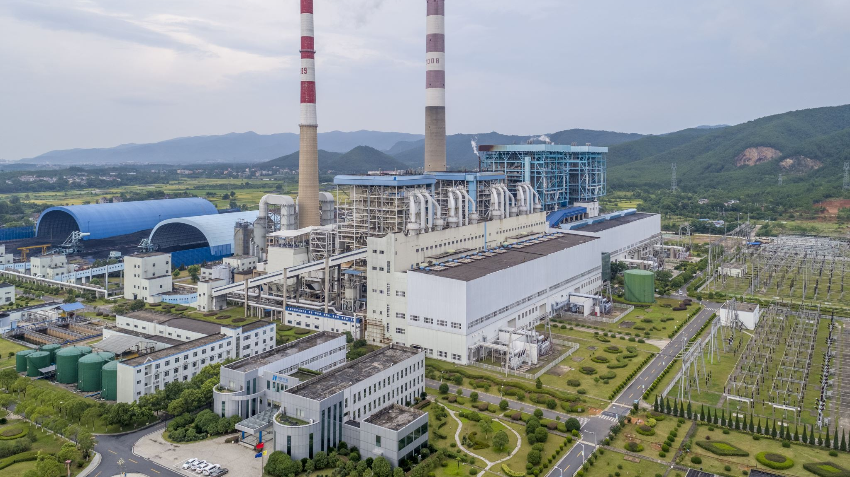
Common Climate Change Causes and Influencers
Carbon Dioxide – e.g., fossil fuel use, deforestation
Methane –one ton warms equal to 86 tons of CO2.
Population Size – People and Animals
Consumption Patterns – All forms of power and other material uses, with waste products
Natural orbital shifts, volcanic activity, forest fires, and regular weather fluctuations and ocean current shifts, independent but can also worsen by climate warming
Plankton, seaweed, permafrost, fungi, and other biological systems can cause and help
Road and city paving, air conditioners, jet plane exhausts, other transporters, and large ships that move sea-life, etc.

Slide 69
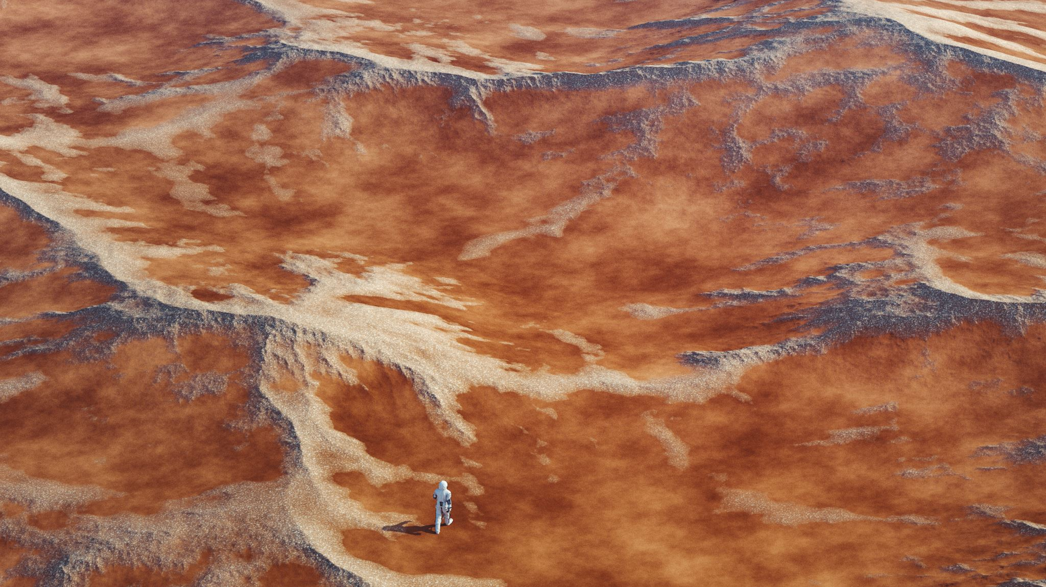
Methane -- A Major Climatoxin
The Global Warming Potential of methane is 84-87, compared to CO2, which is 1.
NASA 2019 data – planet methane release = 590 tons, 360 from manmade sources and cattle (enteric fermentation), decomposing landfills, fossil fuels, coal mines, rice patties.
Burning methane reduces its climatoxicity by turning it into CO2, thereby reducing the warming impact equal to ~85 tons less of CO2 per methane ton.
So 360 million human made methane tons times 85 equals 3.06e9 less GWP CO2 equivalent tons. In a more visual format, that is 3,024,000,000 fewer tons of warming CO2 if we could burn all the methane.
US EPA estimates average automobile emits 4.6 tons of CO2 per year. The human methane release is therefore equal to 720,000,000 automobiles.
Atmospheric methane reduction may be a more rapid way to cool the earth.
Methane reduction is under widespread study.

Slide 70
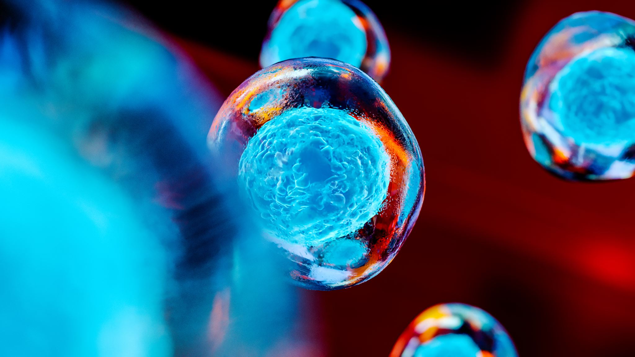
Greenhouse Gases
Atmospheric methane and CO2 molecules absorb infrared radiation reflected from the sun warmed earth. The energy is released but the photons are often recaptured by other CO2 molecules. This is known as radiative forcing, and it adds to global warming.
More CO2 means more molecules exist to capture, and it is a recycling, of sorts, of photons and heat. The heat then radiates down to earth.
Chemical bonds trap the energy, which would otherwise go into space. But methane very strongly holds the heat, more than CO2, allowing more heat to accumulate.
Fewer molecules mean less heat can be captured, and so it is released back to space. The earth then cools.

Slide 71
What Do You Think?
Why would someone deny climate change given the data?
Why do people not think that they too need to make changes to help mitigate the problem? Perhaps they see it as the next generation’s problem, or that science will somehow figure it out, or that we are all doomed anyway, so why not just be a hedonist?
If these thought holders develop solastalgia, how do we approach it?
Sometimes the reality is not accepted until land sinks or agricultural systems change.

Slide 72
climate related fears and anxieties.
Some of it is man-made, and some of it is a natural process.
Some of it may be mitigated, some of it might have been mitigated if we acted earlier and with less politics, and some of it cannot be mitigated.
None of it is avoidable, regardless where we live, our religions, or how much money we have, etc.
All of it, in terms of the impact on our lives, will require all of us to make significant behavioral shifts. Response is also preparation for what will come.
The therapeutic and community endpoint is to develop resiliency and mitigations to a problem that is not ultimately resolvable. We must learn to acclimate to a new relationship our choices and to earth.
It’s necessary to prepare lifejackets that we might never need

Slide 73
Tier 5 Treatment Details to start
First treat any urgent concerns, preparing for heat waves, floods, etc.
Second, study and outline ways to meet longer and more complex core developments, perhaps with the patient or groups.
Ecoanxiety is a good term but needs acute, post-event, and anticipatory sections. Aim for eco - resiliency to be the outcome of eco-anxiety. Dealing with ‘too little too late’ needs real but gentle involvements. No lullaby. Rise to the stress. I find many people don’t know how to make significant changes. Offer ideas that the patient can execute.
Teach how to be in symbiosis with the earth. Again, the earth will win, but that doesn’t mean we will lose.

Slide 74
Tier 5 Treatment – more Details
Usually passive, reticent, phobic, lazy, dependent, or shy people may need initial psychological strengthening.
Modify for learning disabilities, age, religious, cultural or political backgrounds
Consider the surrounding ‘political ecology’– the political-social-economic factors being mixed with climate issues.
Test for cynical, nihilistic, and ennui occurrences. Likewise, listen for the low informed but insistent personality.
Listen to concerns of water and food supply wars.
Listen to concerns about being out of control, which can include anger at leaders, deniers, profit only makers, and the like.

Slide 75
Include the social work and coaching models
Psychiatry has drifted away from integrating the bio-psycho-social model. We too often just give it lip-service. “Go to the psychotherapist for that…”
The biological model for long term climate change issues will fail. Treating the short-term challenges, important as they are, may give a false sense of success or corrections. The very hard to change long term challenges prevail. We face compulsory core changes in lifestyle.
Too often psychiatry ignores or avoids the challenges emanating from the world in which the patients live.
Do not overlook that we live in that same world. That reality should grip our souls.
The penultimate question, therefore, is how do we treat ourselves for this problem. That will teach us how to treat others.

Slide 76
Tier 5 Treatment – even more Details
Canvas for accurate data used for decision making. How to address inaccurate data? Teach the difference between opinion, fact, and egocentrism. Consider the low information voter.
How effective can our treatments be if you have equal feelings? Can sharing this be safe and beneficial? Study the psychosocial dynamics to know if and how to share?
Eco-anxiety can be pre-traumatic and or post-traumatic.
Emphasize proportioned focused behavioral changes. Perhaps be a model.
Strengthen social pressure resilience against doubters, even if the doubter has a controlling position in a person’s life. Teach diplomacy and how to learn from failure.
Teach social and other advocacy behaviors and involvements.

Slide 77
Tier 5 Treatment – a story
A patient with ecoanxiety complained to me that my treatment was akin to getting him to join the Army. I said yes.
I said just making him feel less anxious was wrong. I needed to train him to be properly grounded and to feel stronger. We all need to practice, be coached, and make mistakes.
Then, with new skills and tools, the bad anxiety could begin to reduce itself. Any subsequent anxiety would not be just controlling fear, but rather would face a healthy rechargeable battery to enhance and arm him so to understand how to protect himself and his community.
This is all evenhanded, old-fashioned psychotherapy. No fancy label. Just a different spin on the etiology, problem duration, global, political, and personal dimensions, and a distinctively, ever-shifting footprint as an endpoint. And we too have to do the things as do the patients.

Slide 78
Plastic and convenience for me too… culpa communi sui generis apertus opus est reficiendum numquam desperare community guilt self-made obvious needs to be fixed never loose hope

Slide 79
can we Breakfast without paper and plastic? -- yes!

Slide 80
THANK YOU. THOUGHTS? QUESTIONS?
We must not fail.
Through others we become ourselves
Lev Vygotsky 1896-1934

