Slide 1

Natural Disaster’s Impact on Mental Health
A Broader Perspective
Abbey Strauss, MSW, MD
Boca Raton, Fl
Spring 2024

Slide 2
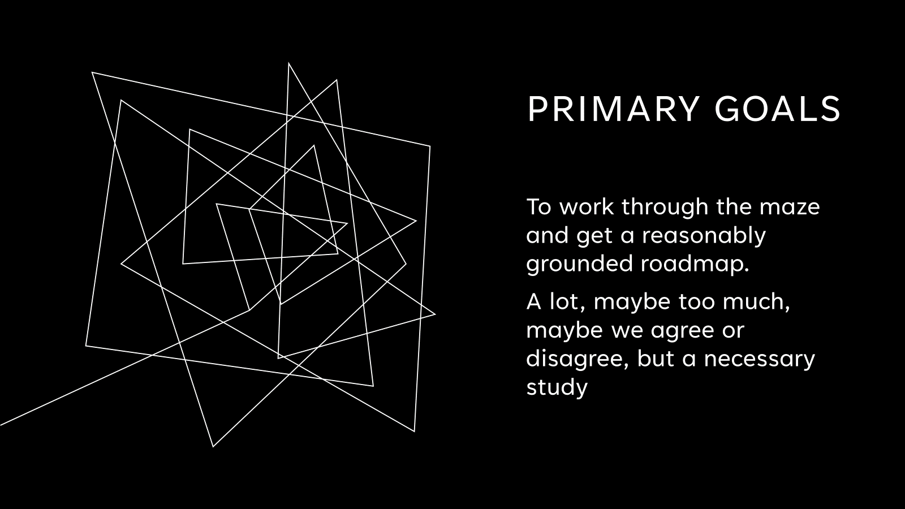

Slide 3
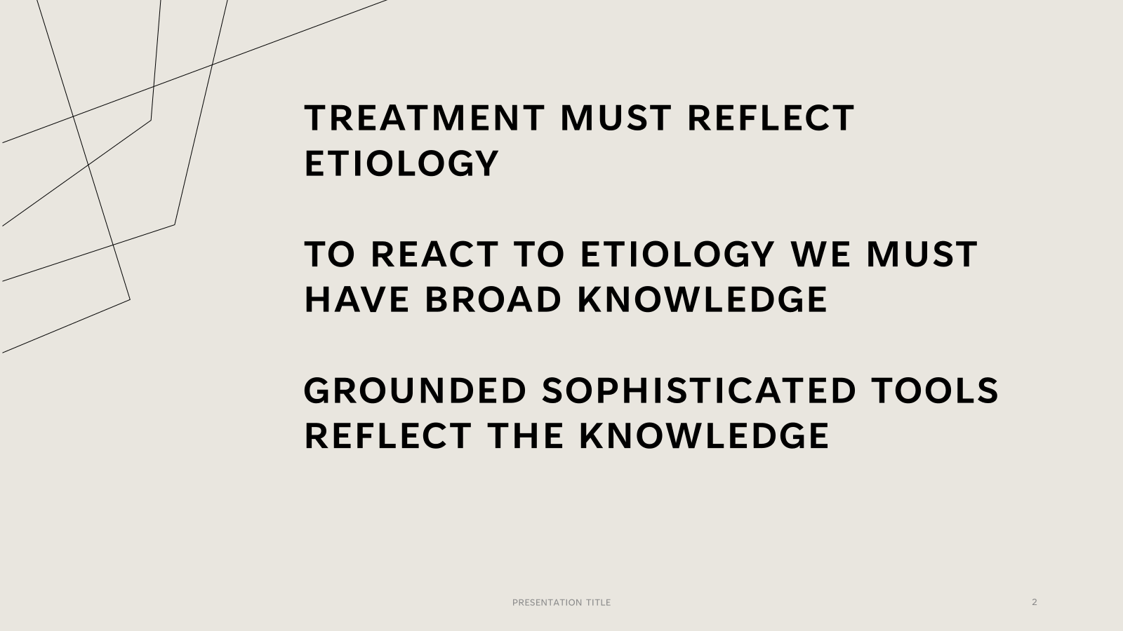

Slide 4
Global warming – very abridged
The sun heats the earth. It lowers the entropy.
Life, via photosynthesis, converts some of the heat into CHO. This is stored as oil and life forms. That heat is unavailable to be released back into space. Without life the earth would heat and cool at the same rate. With life, the earth has less heat to loose. A biosphere then evolves within the cooler earth. The biosphere survives in the temperature ratio of received heat, minus the converted and hoarded heat (as CHO), to the released heat. Earth with life is cooler than without life. In effect, biosphere global temperatures are lower because of less CO2 to block release to space. We today release CO2 from CHO stockpiles faster than the system can process. It’s harder to increase entropy, and so the biosphere warms and impedes its evolutionarily tuned survival tactics.
Some fluctuations can occur from earth axis shifts.

Slide 5
Melting glaciers induce our planet’s axis shifts
The Earth’s axis is changing. Earth’s axis started shifting drastically in 1995, moving the the poles and changing its direction.
The operative agent are the melting glaciers.
Melting glaciers do more than raise sea levels, alter salinity, currents and water temperatures. This can also vary the seasons.
This shift is related to the re-distribution of earth’s weight and masses.

Slide 6
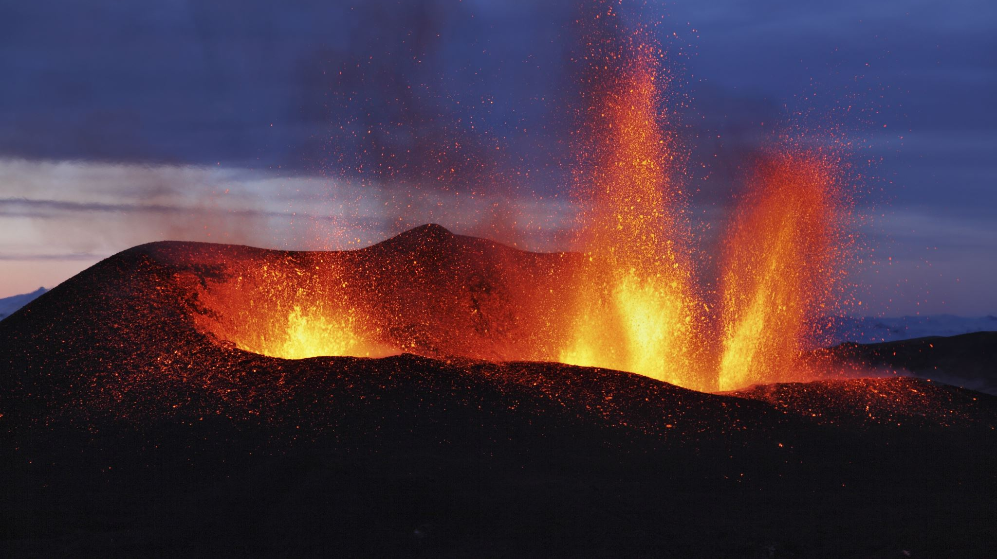
Disasters Have Changed. They Need Different Mental Health Strategies.
  The previously all natural disasters of tornadoes, storms, droughts, some forest fires, and avalanches are now goaded by climate change. Earthquakes and volcanoes are not.
  The psychosocial impacts were once from pure chance events. Not now.
  Future disasters – sea levels, pollutions, water and food sources, are unhurriedly caused by climate change. They will come.
Do we treat the event’s impact or the cause?
If yes, how to do so?

Slide 7
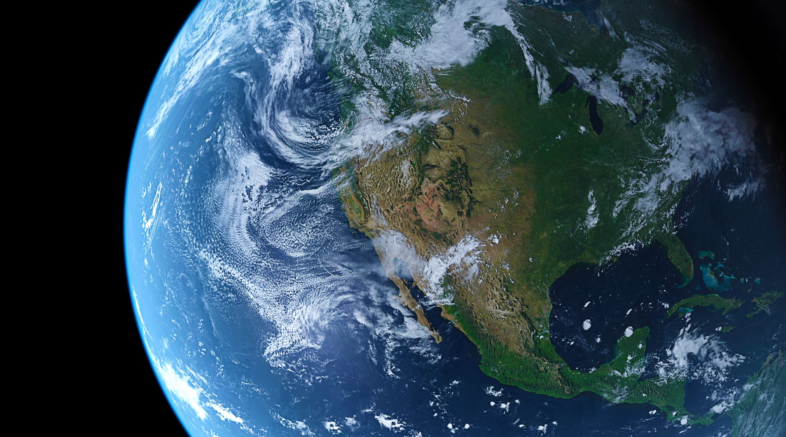
More Concerns
Inside any Therapy
That politics and other countries make things worse is problematic. “Do they not care about me, and apparently for themselves as well?”
Storm disasters. These prompt political and economic questions: how to move to avoid them, and how to rebuild. Who pays for it?
Some insidious climate prompted disasters will come. How do we prepare for the need to move elsewhere to live after the event? Who will pay for it?
Prepare for realizations.

Slide 8
Terms And Concepts
Solastalgia – emotional pain from environmental changes
Climatoxins* -- the major one is our current lifestyles
Eco-resiliency -- the needed endpoint
Eco-security -- not possible
Eco-depression, grief, anxiety, etc. -- reactive and anticipatory
Inescapable and Inevitable Events – they cannot be dismissed or sidestepped, temperature, sea levels, etc
Ennui – Weariness, quiet sluggishness, hopelessness, more personal than community wide.
Nihilism – Pessimism and destruction, turmoil.
Anomie – expecting something that will not occur
Regional and Global Changes – Some are avoidable and some unavoidable, water wars (Kenya), food, land, farm

Slide 9
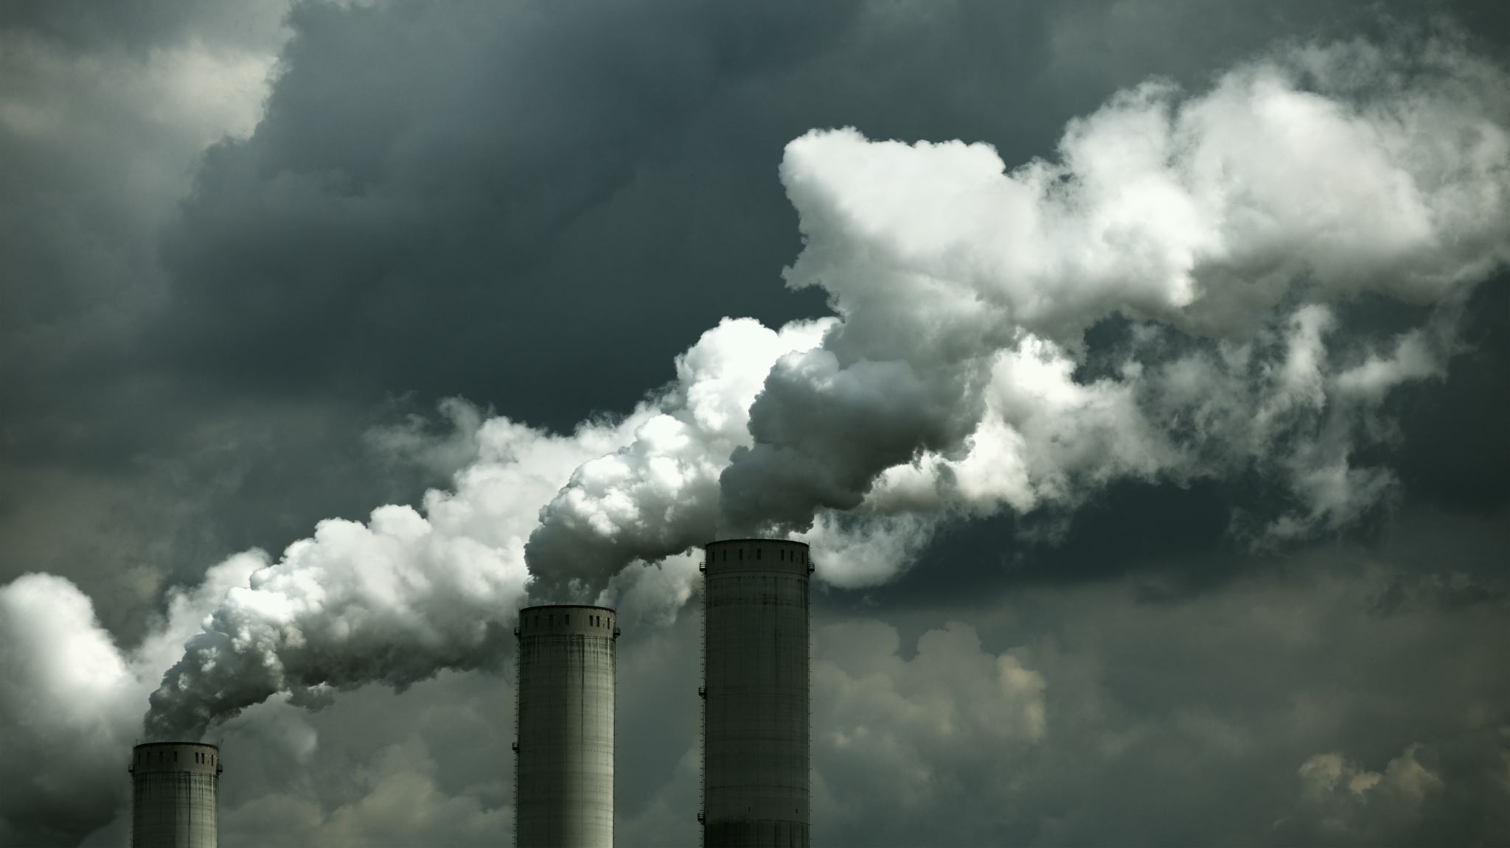
Solastalgia
Coined in 2005 by Glenn Albrecht.
From Latin sōlācium (comfort) and the Greek root -algia (pain, suffering, grief) -- emotional or existential distress caused by environmental changes.

Slide 10
Anomie
Emile Durkheim, in 1897, in his book Suicide, used the term to reflect the malady of the infinite, because it was a desire without limit that can never be fulfilled; it only becomes more intense. He also called it an insatiable will.
Will climate change result in a social uprooting and dissolution of moral and other societal systems if the climate changes become too pressing?
Do we have a desire and expectation, without limit, of what the earth can and will do for us?

Slide 11
Climate –
The Word
Climacteric, from the Greek word klimaktēr, for "critical point" or, literally, "rung of a ladder." It is used for inevitable times on the metaphorical ladder of life. Today, climacteric refers to male andropause or female menopause, with a "turning point leading to an end of something." I was taught the term referenced the male process only.
Historians want to pinpoint the Roman Empire's climacteric, when it began its downhill slide. When is/was/will be ours?
Apocalyptic is its common synonym. The first known use of climate to reference weather was in 1578, somewhat related to latitudes.
Climate used to mean the trend or inclination of weather in a specific region; now it is the full globe. This brings us all together.

Slide 12
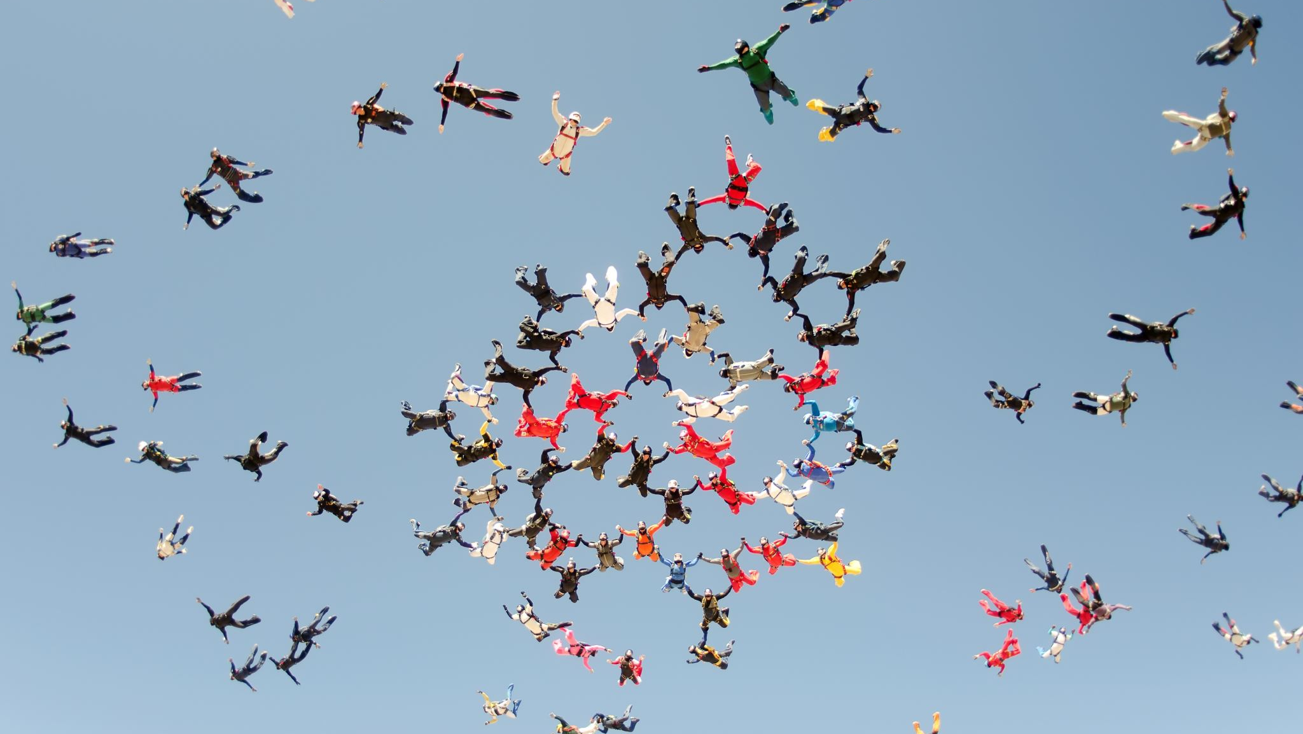
Psychotherapy Approaches
Usual psychotherapy techniques suffice if it is recognized as having a different endpoint – that the external core contributor is not escapable or fixable. Change “what you can, but prepare for more.” Which ‘therapeutic marketing flags’ are waved? Will they just kick the can?
Treatment demands world-wide life-style changes. Beginning anything therefore requires that we cast a spell allowing the hard challenges in front of us not to become stagnation by frustration. To begin demands we break old patterns and reconfigure ourselves. This needs to be done by mixing our courage, tenderness, our psychosocial activities, a sense of our achievable power, and a sense of our vulnerability. It is not easy.
Remember that much of our life is really shaped more by how things end rather than how they start.

Slide 13
Not all, even we here today, are helping – hang on!
Ultimately, if we reduce the population and our consumption patterns, then the climate changes on our planet will become those caused by nature, and not us. Tremendous time and self-discipline will be need, but even with massively effective efforts, it may be too late for our generation to benefit
Equally, the existential panic of realizing that not everybody is helping to make our planet sustainable can be overwhelming and defeating.
How to therapeutically manage that? Do we engender sacrifice, altruism, insight, social activism, etc? Your designs, please.
The alcoholic stops his own drinking, the abused spouse separates, we quit the bad job, etc. We can’t get away from even our own cars and plastic, let alone that in rest of the world.

Slide 14
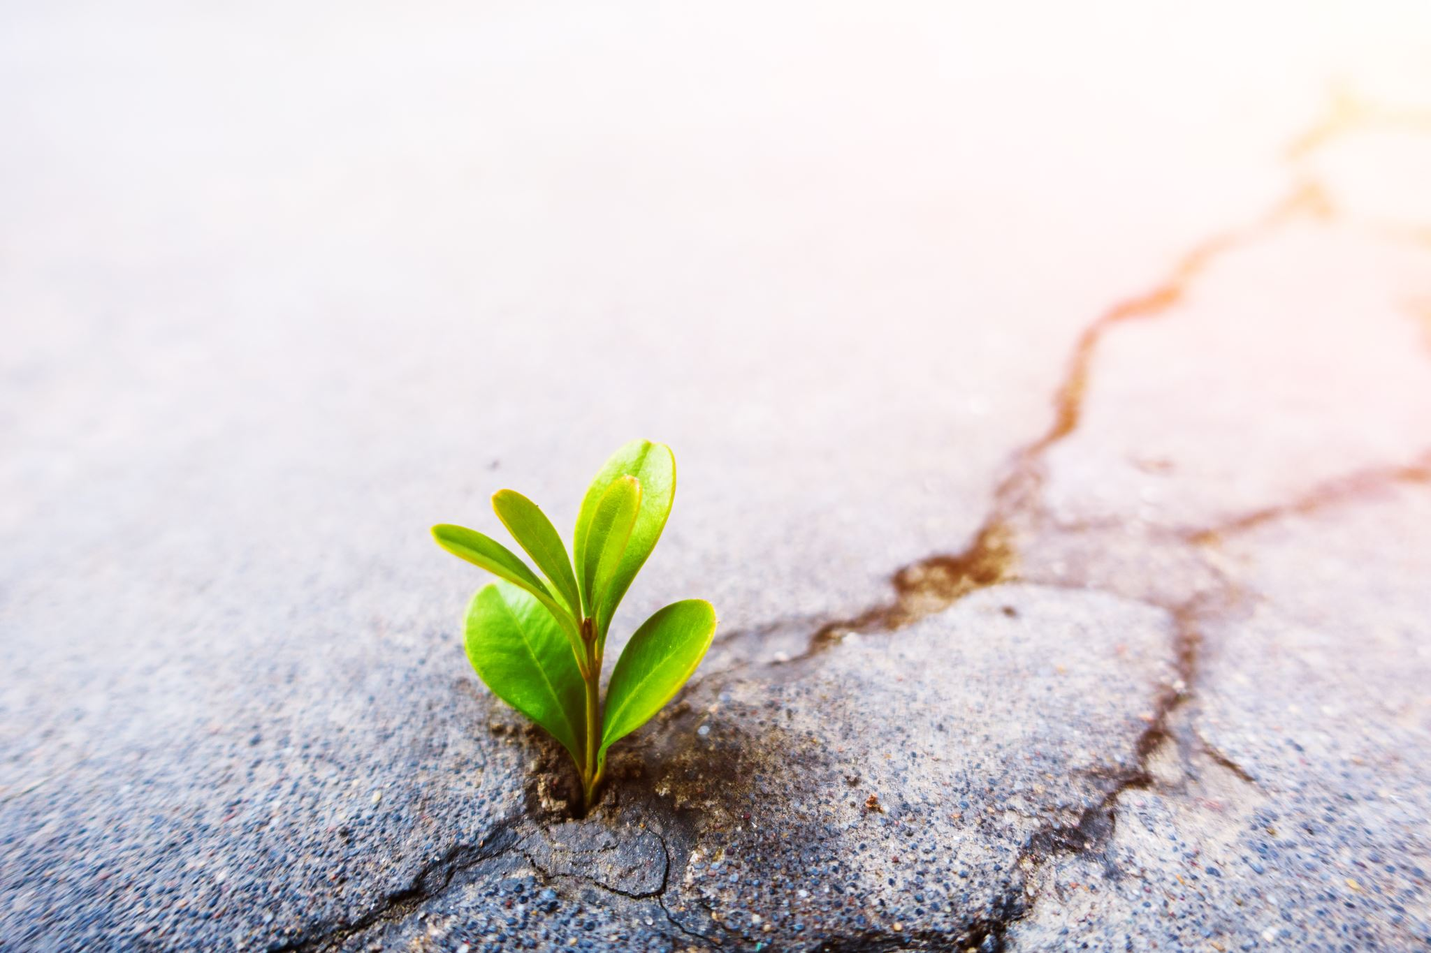
Ecocide – Killing The Ecosystem
Are we the enemies of our own survival? Storms which used to be purely natural are now worsened by climate change.
Therefore, the syllogism exists of we being our own enemies. Do we have the right to demand nature be forced into a type of slavery for us to maintain an uninhibited consumptive short run, and that neither we or nature will survive this ‘run’ of consumption patterns.
Ecuador has declared that the planet has legal rights of protection. Should trees have equal legal rights? They are living entities, as we are, but we don't seem to really care enough about them.

Slide 15

Ecocide Background
Ecocide -- fro the Greek oikos for home, and Latin cadere, for kill.
It is described as the unlawful or wanton acts committed with knowledge that there is a substantial likelihood of severe and either widespread or long-term damage to the environment being caused by these acts.
Ecocide has been stopped by law in many countries, including the EU.
It can refer to both peacetime and war occurance if there is a destruction of the environment. Stalin did it to Ukraine in the 1930’s.

Slide 16
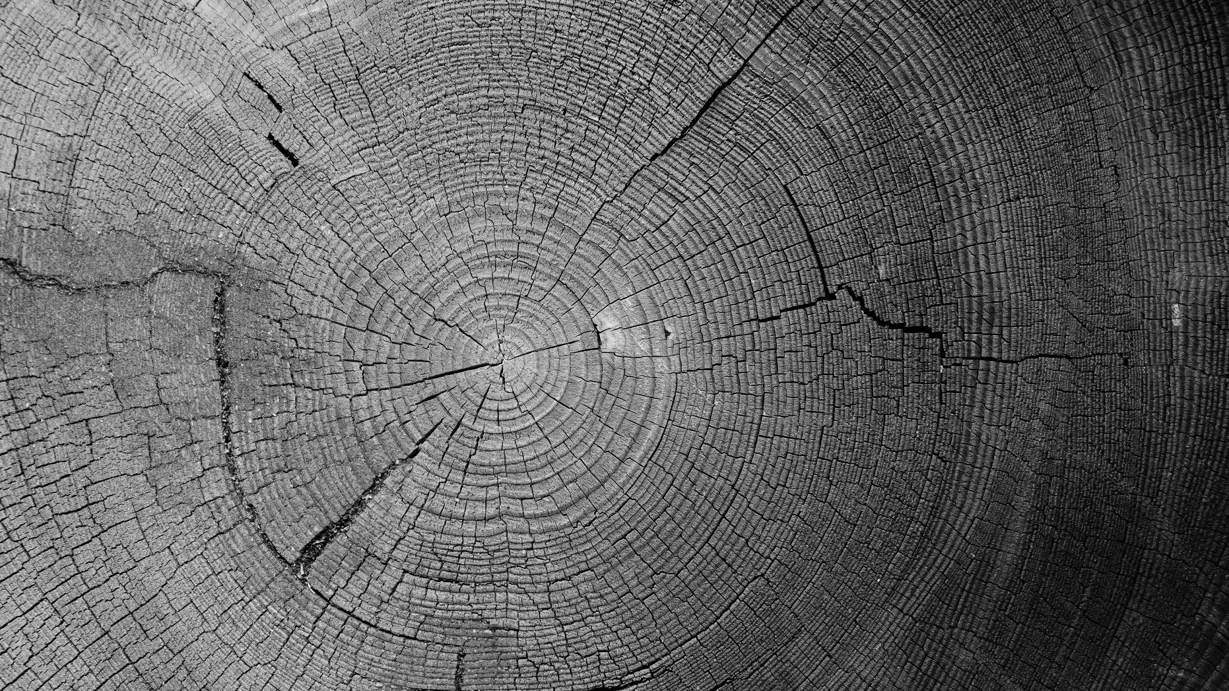
The reality of our cultures
We must accept the reality of our cultures. We must not sidestep the bite-our-lips reality that technologically we do not yet know how to rapidly enough repair the Earth's climate illness.
What will be the postmortem explanation of this climate disease? What will be the real diagnosis? “Dishonored by the occupant’s life-styles?”
Perhaps our own profession underwrites the problem more than we realize because we are taught to treat diseases more than to prevent them.
We must not just prevent and treat diseases of the individual, but also of the biosphere.
We are like the rings of a tree.

Slide 17

The Zeitgeist
Of Our Times
A zeitgeist is the general intellectual, moral, and cultural climate of an era. It is also considered to be an invisible agent or force, a spirit, that characterizes a given epoch. Philosophers see it being currently used, somewhat colloquially, as a system of fashions, fads, or social architectures.
What zeitgeist will be in history’s descriptions of this part of our existences? Will there be someone to record history?
Our psycho-climate challenge parallels our fight against obesity. It takes discipline, time, and inconvenience to eat healthier in order to lose weight. It takes the same philosophy to address climate change. We cannot slip into a parallel of Ozempic-like tools for climate control.
Which leads directly to what we, as mental health treaters, are being asked to treat versus what we need to treat.
Which returns us to the Zeitgeist.

Slide 18
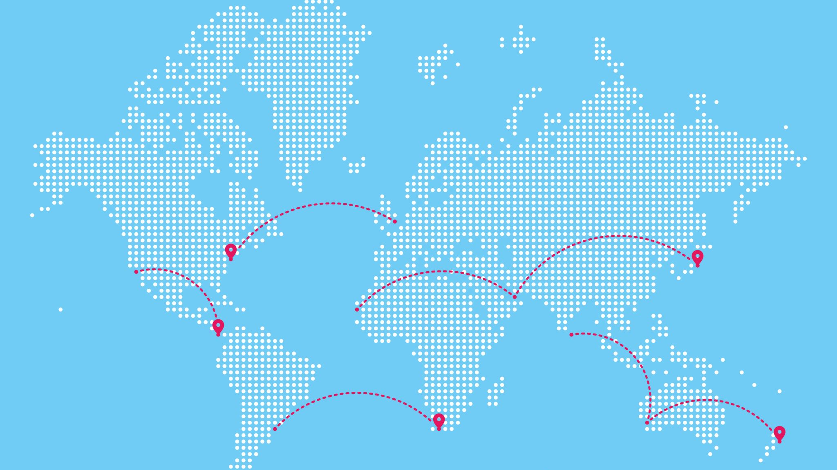
Some clicking points – a rest stop for our trip
The usual formats of psychotherapy is sufficient as long as it is recognized now as having a different therapeutic endpoint – the core contributor is not escapable or fixable. Resiliency needs some inconvenience and personal change.
Treatment demands some world-wide life-style changes that will be troublesome. “Ok, my part is tiny, albeit it is important.”
Going green is perhaps still too faddish that helps only a little, but it is a start.
The feared endpoint is an increase in world temperature of 1.5° C by 2030. (Some estimates up to 2050.)
The challenge is largely the global population size and our consumption patterns. These behaviors apply to us as well – which is a bite we all need to take. What have you done to change?

Slide 19
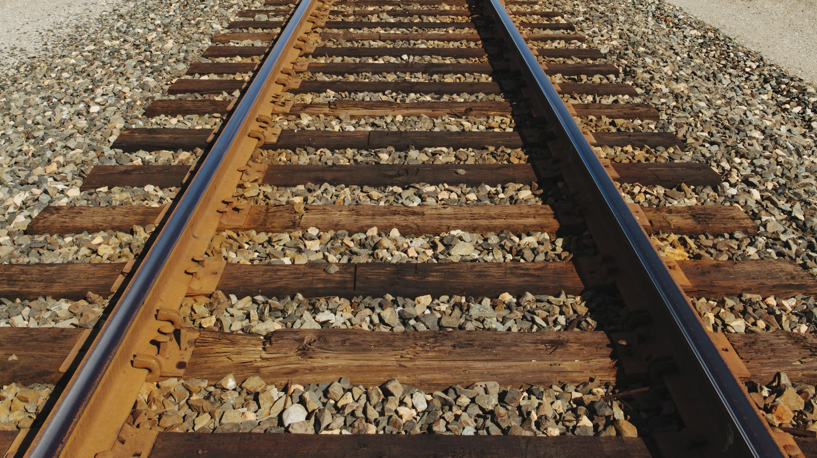
The Emotional Response Starts
Like war zones, many of these battles have yet come to our hard homes. The ratio of watching to feeling the changes is still more watching.
When a natural disaster hits our home and lifestyle, it can cause an intense emotional back-lash. “The hurricane was worse because the ocean was warmer, and our house went under water! I didn’t realize that two degrees made such a difference, and the ocean is so big, how can this happen to it, and then to us? And now you tell me more like this is to come?”
An indirect natural disaster hit can have an equal response. “I grow apples, and climate change reduced the bee population, and we ended with up fewer apples and I’m losing money…”

Slide 20

Human stirred disasters – they do not come and go. They stay
Sea rise and losses of places to live
Ocean temperature rising, changing ocean current events
Sea water going into fresh water
Acidification of the oceans
Plankton blooms and oxygen dead zones
New agricultural patterns, growing seasons, & bee populations, etc.
Longer, more intense heat events with all its implication
Sewage and pesticide run offs, carbon sinks, methane rise
Deforestation
Our Fuel Consuming Life-styles and Population Growth

Slide 21
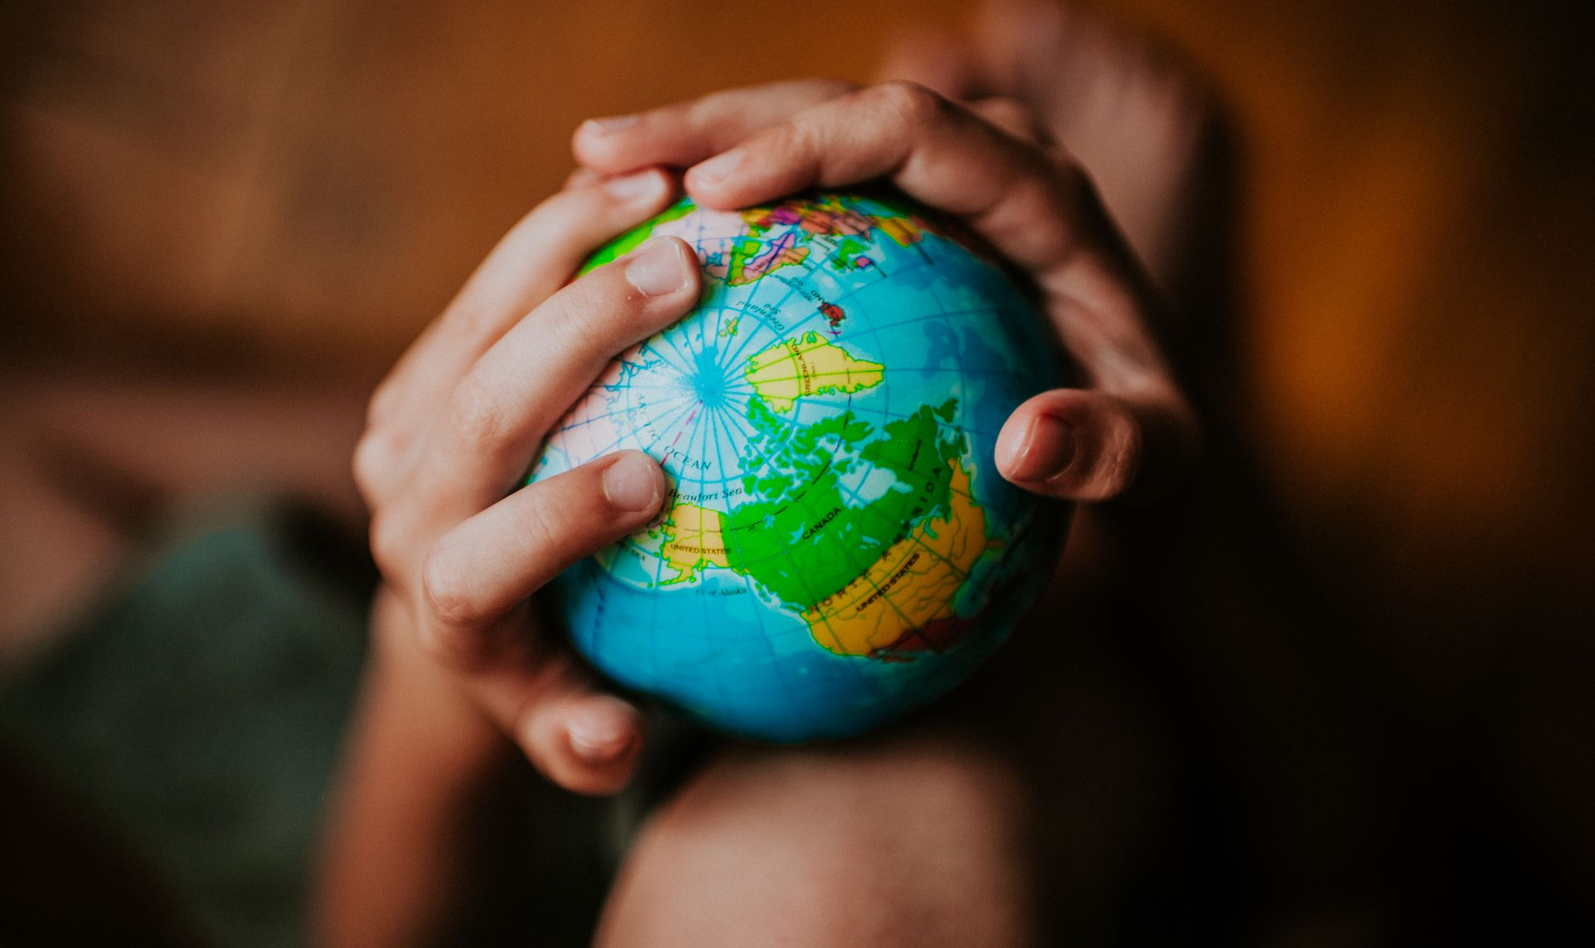
Caveats on Mental Health Interventions
Our psyches live in the same biosphere as our bodies.
Teaching about heat events requires nothing new other than doing it a bit more rigorously. We should have done this all along. Its just that the heat is worse, more people live in hard to cool places, there are more heat incidents, the population is older, and the heat durations are longer. And for many, the intervention is to use more air-conditioning. is underpowered or not available!
Teaching ourselves, and our patients, how to plan for climate related events is critical, but it must be done without panic, even as we tell them it may only get worse. “Doc, I’m afraid of the future? Yes.”

Slide 22
Define the challenges
Carefully define the challenges, and then offer skills accordingly.
Some skills will be to modify the amendable provincial challenges, and some will be on how to live with unmodifiable challenges.

Slide 23
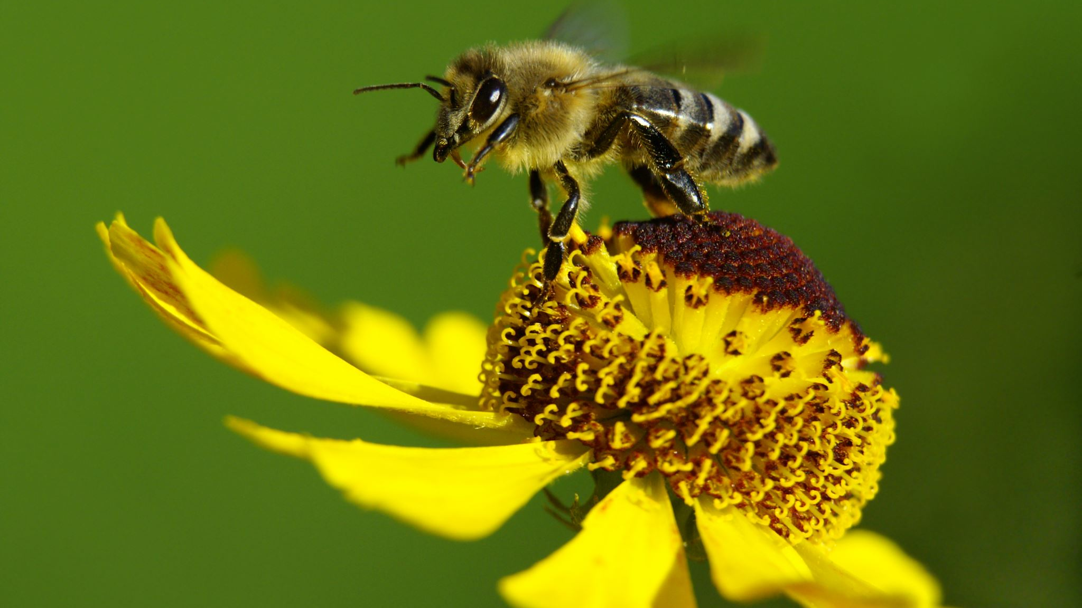
Climate Change,
The Bees,
The Flowers, Our Food,
Our Emotions, Our Resiliency
Bees depend on scents to search for plant nectar, which is their food. Floral scents are unique to each flower and plant. Bees have a special ability to remember these scents in their search for pollen. Climate change has resulted in plants changing their scents because they are climate stressed. As a result, it is difficult for bees to find plants for food, leading to the loss of bee population.
Timing is crucial for pollination, as flowering and hatching must coincide for successful pollination to take place. Climate change has resulted in the mismatch between the period when flowers produce pollen and when the bees are ready to feed on the pollen—decreasing seed production and causing food shortages.
National Pollinator Week: The Climate Threat to Bees | Department of Energy

Slide 24

More caveats about managing the feelings
Two themes may arise - a fear that it is too much out of control, and so too late, and so a great anger that more was not done beforehand.
Prepare for ennui, nihilism, egocentrism, fatalism, hedonism, religious passion and appetite, persevering denials, and solastalgia.
Meter the intervention capacities of the ego. Treatment may need a hard focus on what they productively need do to help themselves and the community. They may feel overwhelmed. Something this big is new.
Inquire where they get nontoxic information about climate change.
Treatment requires screening for thought disorders, minor cognitive impairments, age, cultural backgrounds, etc.
Remember we are talking about the survival of our biosphere and those who live within it. That may be too much for some people to consider.

Slide 25
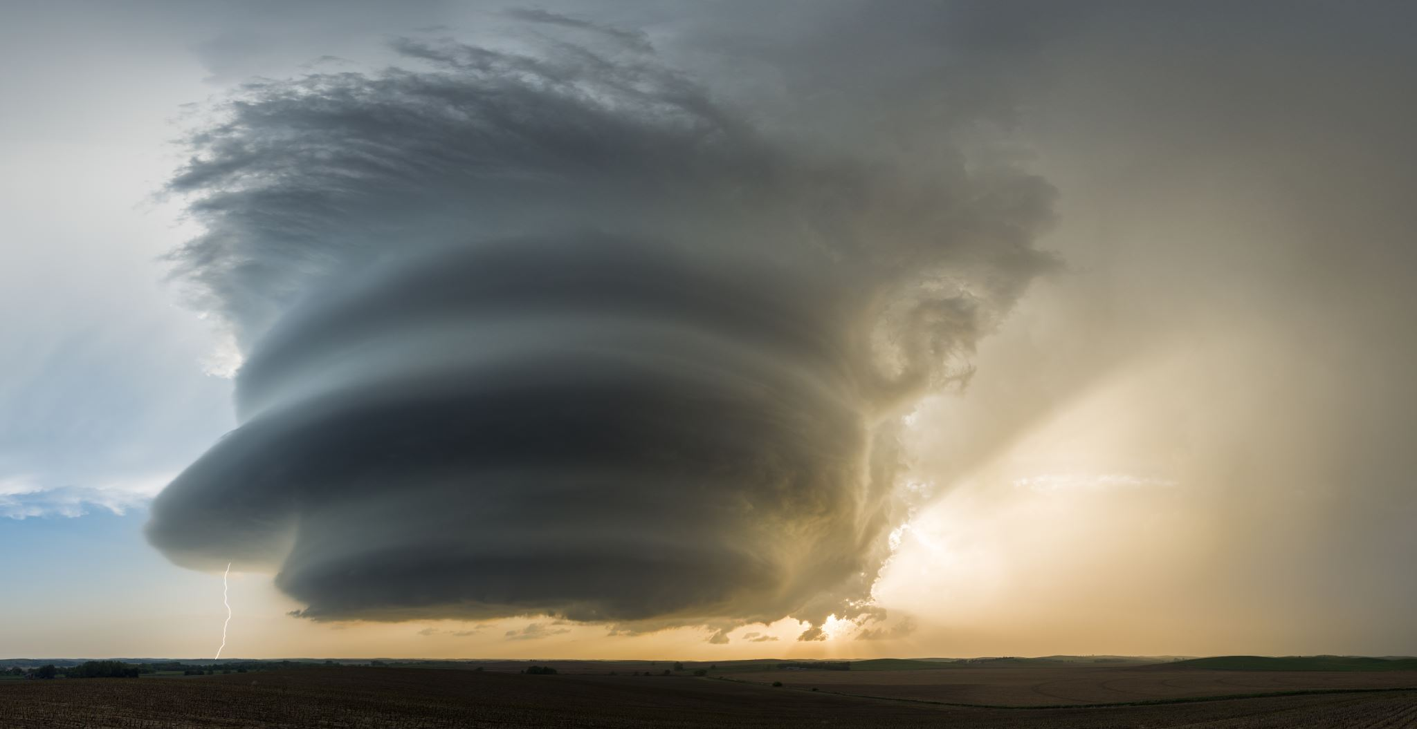
Outlining Caveats….
A purely natural disaster, such as a tornado, can be used for the context that the world normally has such events. If natural events cause panic, then a deeper level of developing endurance skills first need to be addressed. Blending in climate change may at first be too overwhelming.
The therapist needs to be endlessly aware that climate change emotional distress has a different existential endpoint. It is learning to live with an unsolvable problem, and yes, we will have to make many life-style changes. The earth will ultimately win, but we do not necessarily have to lose. And straight science may not be able to rescue us in a fast enough manner.

Slide 26
if the earth is not predictable and safe the way I expect it to be… what happens to us?
Basic pre-treatment questions we must ask ourselves:
Are we bringing too much existentialism into the therapy mode? Can patients handle it? Can we handle it?
Is unlabeled climate change induced existentialism by itself infiltrating into the psyches in manners we are not prepared to treat?
The world maybe permanent for our life spans, but not more. This uncertain mutability may be unnerving to many; how might this be discussed, and even prepared for, for all of us?
Are we misleading if we do not bring in the existential ticket?
How do my ego strengths compare to other peoples’ ego strengths?

Slide 27

What Are Our Goals
As We Prepare To Treat Others
What is the origin of the anxiety? What is the treatment endpoint?
Are we treating to lower the triggers or to lessen the responses?
When and if should medications be used for the mental health?
What treatment model should be used – CBT, DBT, EMDR, insight psychotherapy, pastoral, resilience training, desensitization, anger management?
Can we introduce reality and avoid panic?
Consider comorbid issues – egocentrism, personality issues, fragile egos, substance abuse, OCD, immaturity, real financial or job issues, religious issues, denial, thought disorders, etc.
How to handle those who have deeper existential fears?

Slide 28
What is In The News?
Arsht-Rock (climateresolve.org) is deploying impactful and sustainable solutions by putting policy into action and paving the way for new climate resilience finance and innovative insurance approaches for people, cities, and countries.
Climate-aware therapists are trained to look for signs of climate-based distress and anxiety and help their patients become more resilient. (verywellhealth.com)
The APA Committee on Climate Change and Mental Health is identifying the key components of curricula on climate-related issues. (Psychiatric News, APA, May 25, 2022)

Slide 29
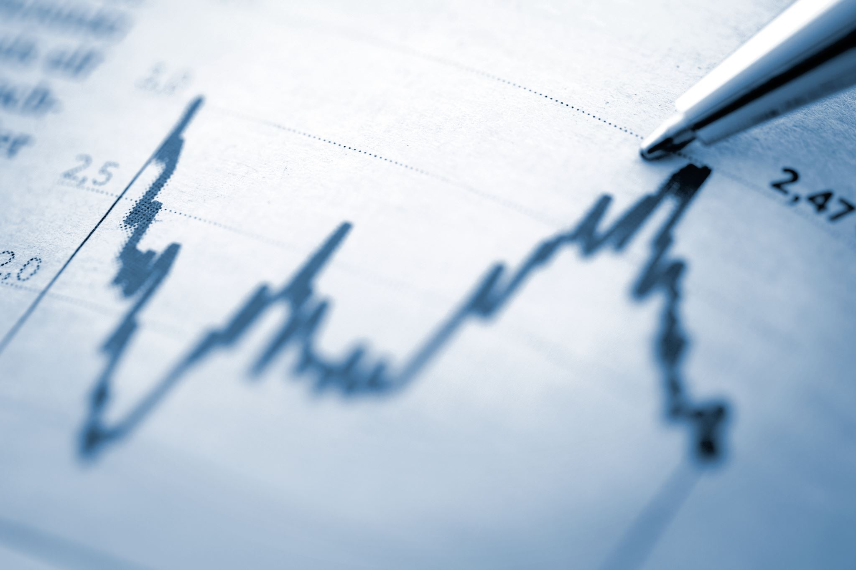
The real endpoint
The European climate agency Copernicus said the year (2023) was 1.48 degrees Celsius (2.66 degrees Fahrenheit) above pre-industrial times. That’s barely below the 1.5 degrees Celsius limit that the world hoped to stay within in the 2015 Paris climate accord to avoid the most severe effects of warming. (AP. Jan 9, 2024)
What would it take to cool the earth back to a ‘safe level’? Stopping temperature rises may be the wrong end point. This is key!
James Hansen, whose testimony to the US Senate in 1988 is cited as the first high-profile revelation of global heating, warned in a statement with two other scientists that the world was moving towards a “new climate frontier” with temperatures higher than at any point over the past million years, bringing impacts such as stronger storms, heatwaves and droughts.

Slide 30
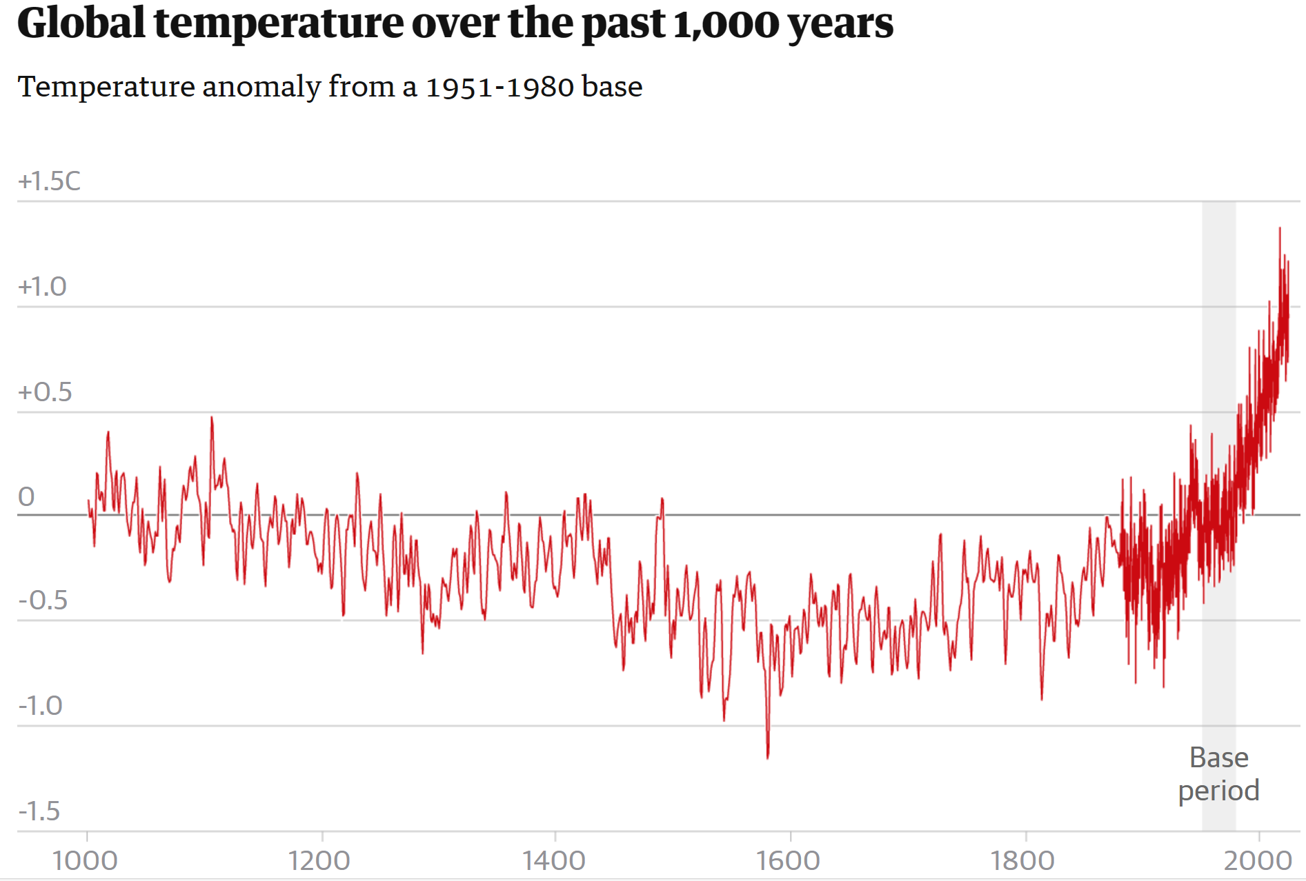
From NASA – 1000 years

Slide 31
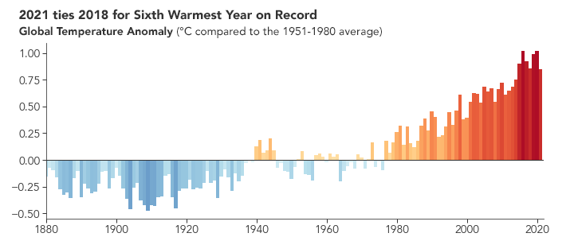
1880-2021 Warming trends - NASA

Slide 32
Temperature Baselines
The year 2022 was the sixth warmest year since global records began in 1880 at 0.86°C (1.55°F) above the 20th century average of 13.9°C (57.0°F).
What happened in 1980?

Slide 33
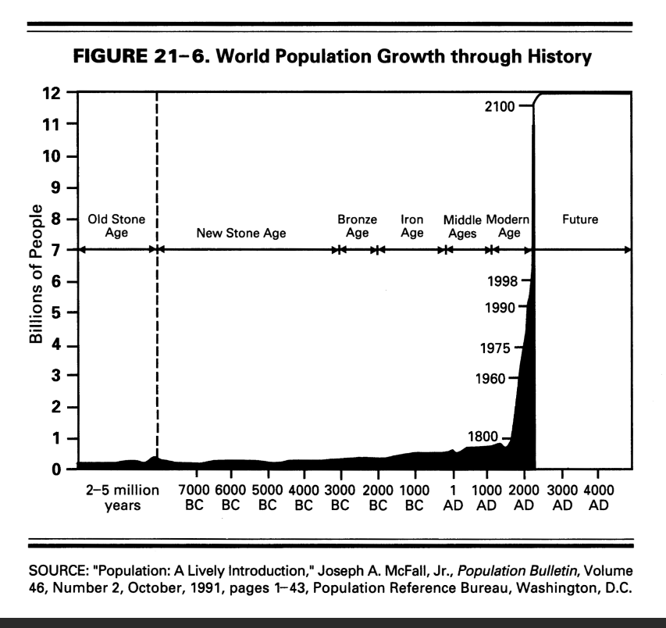

Slide 34
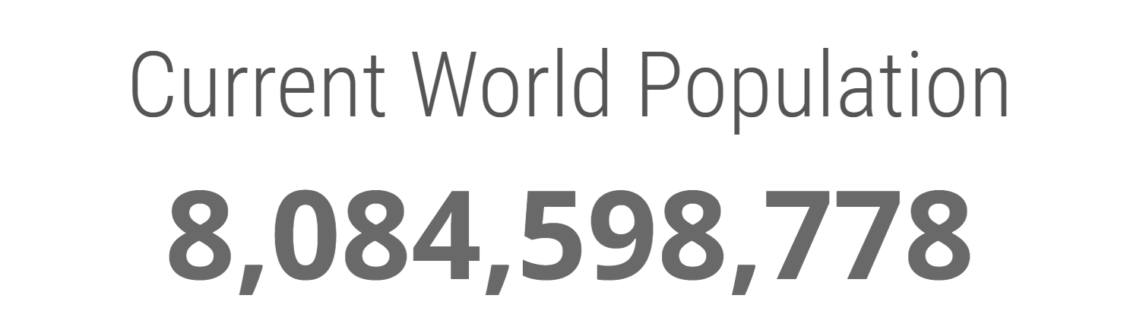
As of January 11, 2024 --

Slide 35

Do We Treat The All-Natural Vs Mixed Caused Disaster With A Different Focus?
Yes. Those former distinctions may no longer exist.
How much do we educate and treat about the future versus immediate post-disaster symptom – wherein rests the larger worry?
How much existentialism do we need to bring into the treatment?
Should we begin with an etiology distinction – is it all natural or mitigated?
Or how do we respond to this: “I don’t care about the future, just make me less anxious.”
What happens if we learn there is anger at the loss of normal and expected life choices?
Let’s stop and have some discussion of these as starting points

Slide 36
The deeper questions…
What are our expectations of earth’s workload ability? Are we finally living the results of exhausting its resiliency? Can the earth support both our population and our expectations to support our needs and pleasures?
Do we have to wait for the earth to recycle itself? WILL a few years of living a greener life, and with better carbon or other sinks, produce that different of a end product?
Are we working to maintain a new lifestyle, or are we trying to re-achieve the older and less climate change compulsory lifestyles modifications?
The question “Wait! I studied this and it is bigger than I thought. Can you truly help?”
The answer “Not that easily. But let’s find a path in a mult-realm strategy.”
The ennui factor: “are we too late? Or is the best we can do is to maybe slow it up a little?”

Slide 37

Some basics we are expected to know
Back to basic science. We too often treat the symptoms more than the origin – this takes away from our treatment depths and effectiveness. We need hard knowledge of:
  Psychological basic science and theory, as well as the theories of therapy types, i.e., which ones do we use with this clinical challenge?
  Biological basic science – what, how, and why is the climate changing
Be aware of religion-economics-political sciences. Patients hear what is not being done. How do we deal with their reactions to that?
Look at ourselves – how much of what we give to patients have we done to ourselves? What are we being true to if we drive a gas guzzler? Or leave the lights on, etc. Have we changed behaviors before we ‘treat’ others to do so? What do we really believe?

Slide 38
Avoiding
Rube Goldberg Models & Pitfalls
A "machine“ (or treatment model) is often presented on paper that would be impossible to implement in actuality.
Many therapy models exist. Some of them may be Goldberg machines when dealing with climate change.
One universal impediment is when too much confidence rests that legislation will repair or prevent, even if it is often possible to implement.
The Goldberg model is prevented when people make real personal changes. The healthy tsunami builds from the bottom up and not the top down, though it helps if the top executes the same goals. Good leaders must pollinate the bottom-up undertaking.
We must prevent Goldberg models.

Slide 39
A basic philosophic and science concept primer
We are fundamentally taught to treat more than to prevent diseases. To best treat we must know what and how to prepare.
But this time the preparation is not for diseases of the individual; it is of the diseases of the biosphere. It must be a global public health effort.
Life-style is a key concern. As with treating body weight, it takes time and discipline to embrace healthier life-styles. We sell pills or injections so, without too much work, to restore a prior baseline life-style. Is that wrong?
It is mandatory for all of us facing the same climate change issues: What behaviors have you changed? Can we ethically teach what we don’t do?

Slide 40

A Core Scientific slope
The earth is warming – that is a fact.
We have theories to propose why that is happening. The consensus is that the theories are correct.
But we have yet to ultimately falsify those hypothesis and theories. Not every idea is – or can be -- tested or proportionally rated.
The premise of what and how we are trying to correct our biosphere is just the most contemporary thought. We are using the beta version of climate change science.
On April 12, 1955, Salk said Sabin’s vaccine was dangerous. In 1960, the US Army endorsed Sabin. In 1983, US CDC blamed 99 polio case on Sabin. The Salk vaccine replaced it in 1999. true today and not true tomorrow?
The same is true for mental health treatment. What testable experience do we have treating such a global inevitability?

Slide 41
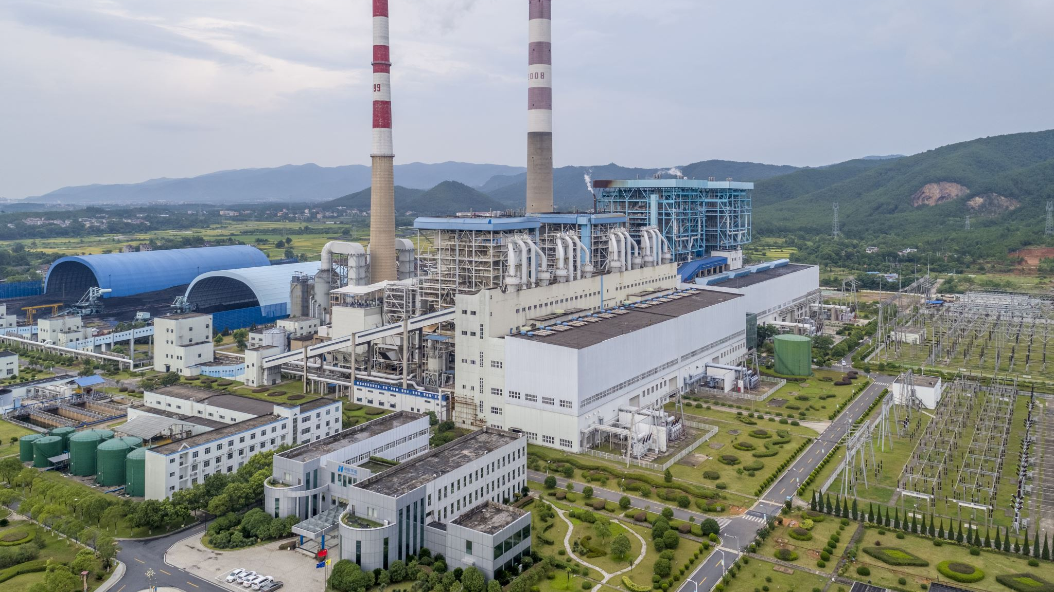
The Common Climate Change Causes and Influencers
Carbon Dioxide – e.g., fossil fuel use, deforestation
Methane –one ton warms equal to 86 tons of CO2
Population Size – People and Animals
Consumption Patterns – All forms of power and other material uses, with waste products
Natural orbital shifts, volcanic activity, forest fires, and regular weather fluctuations and ocean current shifts, independent but can also worsen by climate warming
Plankton, seaweed, permafrost, fungi, and other biological systems can cause and help
Road and city paving, air conditioners, jet plane exhausts, other transporters, and large ships that move sea-life, etc.

Slide 42
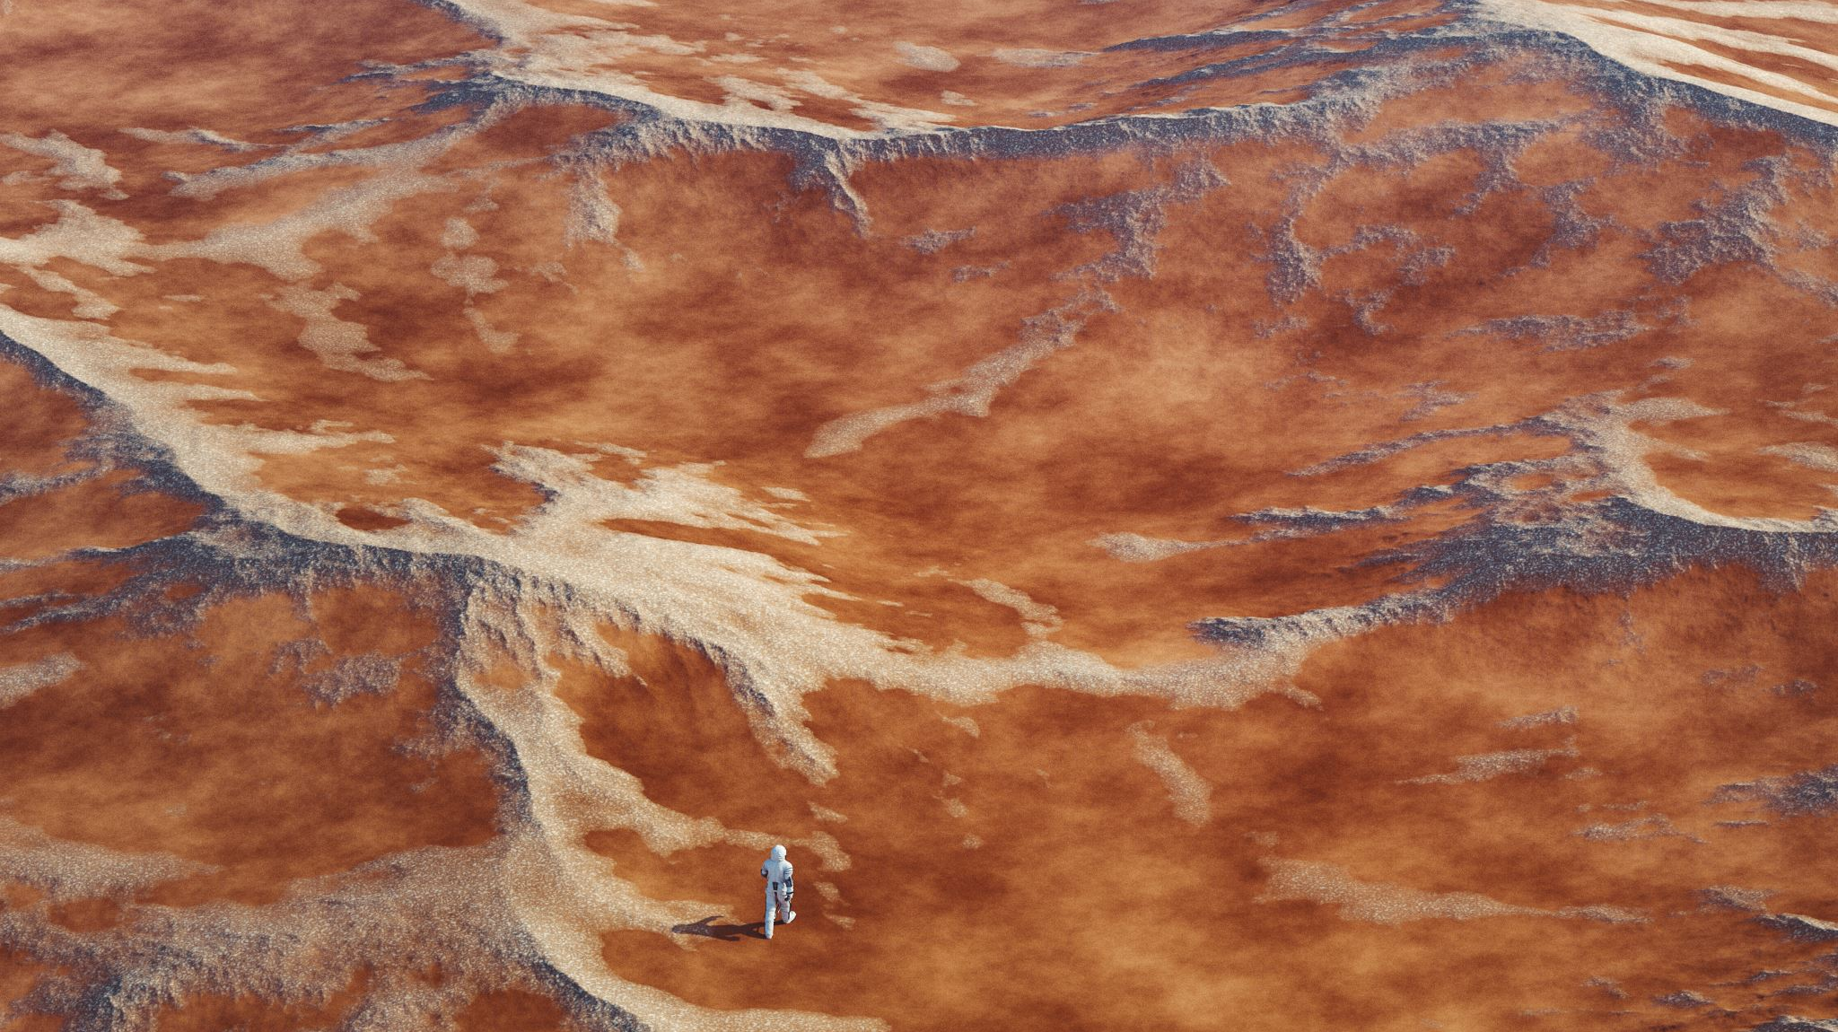
Methane -- A Major Climatoxin
The Global Warming Potential of methane is 84-87, compared to CO2, which is 1.
NASA 2019 data – planet methane release = 590 tons, 360 from manmade sources and cattle (enteric fermentation), decomposing landfills, fossil fuels, coal mines, rice patties.
Burning methane reduces its climatoxicity by turning it into CO2, thereby reducing the warming impact equal to ~85 tons less of CO2 per methane ton.
So 360 million human made methane tons times 85 equals 3.06e9 less GWP CO2 equivalent tons. In a more visual format, that is 3,024,000,000 fewer tons of warming CO2 if we could burn all the methane.
US EPA estimates average automobile emits 4.6 tons of CO2 per year. The human methane release is therefore equal to 720,000,000 automobiles.
Atmospheric methane reduction may be a more rapid way to cool the earth.
Methane reduction is under widespread study.

Slide 43
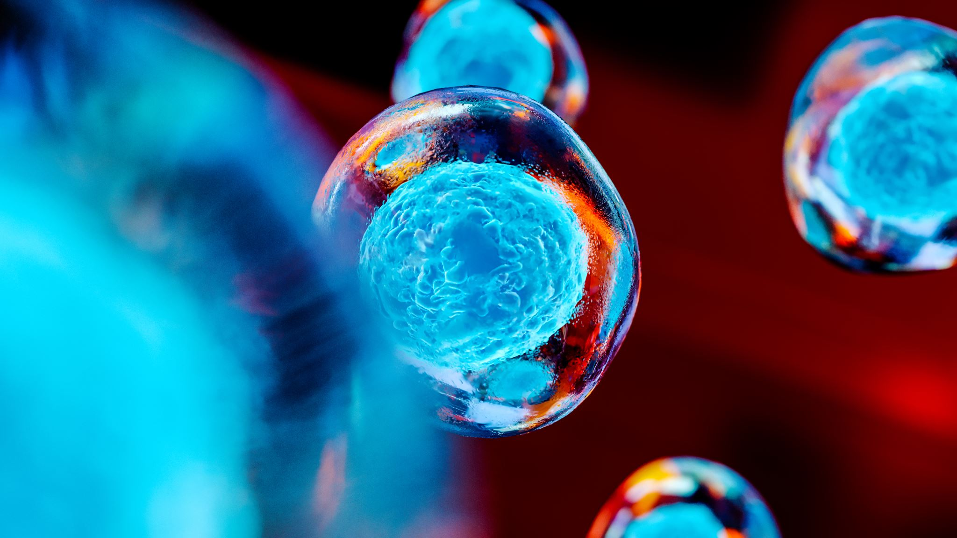
Greenhouse Gases
Atmospheric methane and CO2 molecules absorb infrared radiation reflected from the sun warmed earth. The energy is released but the photons are often recaptured by other CO2 molecules. This is known as radiative forcing, and it adds to global warming.
More CO2 means more molecules exist to capture, and it is a recycling, of sorts, of photons and heat. The heat then radiates down to earth.
Chemical bonds trap the energy, which would otherwise go into space. But methane very strongly holds the heat, more than CO2, allowing more heat to accumulate.
Fewer molecules mean less heat can be captured, and so it is released back to space. The earth then cools.

Slide 44
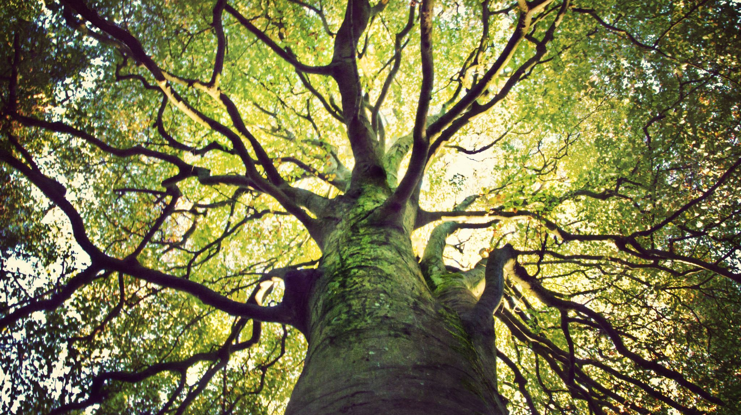
A few thoughts
For years, those making climate change warnings were ridiculed and called tree huggers, killjoys, spoilsports, pessimists, weak worry warts, anti-growth, etc.
Frame this denial in egocentric terms.
The three common steps to advancement – i.e., with the
real de facto ‘scientific method’ –
    That’s impossible, wrong, or crazy.
    Then, well, ok, maybe that might make sense.
    Finally, but of course, it’s so oblivious…why did we miss it?

Slide 45

What Do You Think?
Why would someone deny climate change given the data?
Why do people not think that they too need to make changes to help mitigate the problem? Perhaps they see it as the next generation’s problem, or that science will somehow figure it out, or that we are all doomed anyway, so why not just be a hedonist?
If these thought holders develop solastalgia, how do we approach it?
Sometimes the reality is not accepted until land sinks or agricultural systems change.

Slide 46
climate related fears and anxieties.
Some of it is man-made, and some of it is a natural process.
Some of it may be mitigated, some of it might have been mitigated if we acted earlier and with less politics, and some of it cannot be mitigated.
None of it is avoidable, regardless where we live, our religions, or how much money we have, etc.
All of it, in terms of the impact on our lives, will require all of us to make significant behavioral shifts. Response is also preparation for what will come.
The therapeutic and community endpoint is to develop resiliency and mitigations to a problem that is not ultimately resolvable. We must learn to acclimate to a new relationship our choices and to earth.
It’s necessary to prepare lifejackets that we might never need

Slide 47
Tier 5 Treatment Details to start
CPT Z-277 - the code for a response to environmental hazards – but is not billable.
First treat any urgent concerns, preparing for heat waves, floods, etc.
Second, study and outline ways to meet longer and more complex core developments, perhaps with the patient or groups.
Ecoanxiety is a good term but needs acute, post-event, and anticipatory sections. Aim for eco - resiliency to be the outcome of eco-anxiety. Dealing with ‘too little too late’ needs real but gentle involvement. No lullaby. Rise to the stress. I find many people don’t know how make significant changes. Offer ideas that the patient can execute.
Teach how to be in symbiosis with the earth. The earth will win, but that doesn’t mean we will lose.

Slide 48
Tier 5 Treatment – more Details
Usually passive, reticent, phobic, lazy, dependent, or shy people may need initial psychological strengthening.
Modify for learning disabilities, age, religious, cultural or political backgrounds
Consider the surrounding ‘political ecology’– the political-social-economic factors being mixed with climate issues.
Test for cynical, nihilistic, and ennui occurrences. Likewise, listen for the low informed but insistent personality.
Listen to concerns of water and food supply wars.
Listen to concerns about being out of control, which can include anger at leaders, deniers, profit only makers, and the like.

Slide 49
Tier 5 Treatment – even more Details
Canvas for accurate data used for decision making. How to address inaccurate data? Teach the difference between opinion, fact, and egocentrism. Consider the low information voter.
How effective can our treatments be if you have equal feelings? Can sharing this be safe and beneficial? Study the psychosocial dynamics to know if and how to share?
Eco-anxiety can be pre-traumatic and or post-traumatic.
Emphasize proportioned focused behavioral changes. Perhaps be a model.
Strengthen social pressure resilience against doubters, even if the doubter has a controlling position in a person’s life. Teach diplomacy and how to learn from failure.
Teach social and other advocacy behaviors and involvements.

Slide 50
Tier 5 Treatment – a story
A patient with ecoanxiety complained to me that my treatment was akin to getting him to join the Army. I said yes.
I said just making him feel less anxious was wrong. I needed to train him to be properly grounded and to feel stronger. We all need to practice, be coached, and make mistakes.
Then, with new skills and tools, the bad anxiety could begin to reduce itself. Any subsequent anxiety would not be just controlling fear, but rather would face a healthy rechargeable battery to enhance and arm him so to understand how to protect himself and his community.
This is all evenhanded, old-fashioned psychotherapy. No fancy label. Just a different spin on the etiology, problem duration, global, political, and personal dimensions, and a distinctively, ever-shifting footprint as an endpoint. And we too have to do the things as do the patients.

Slide 51
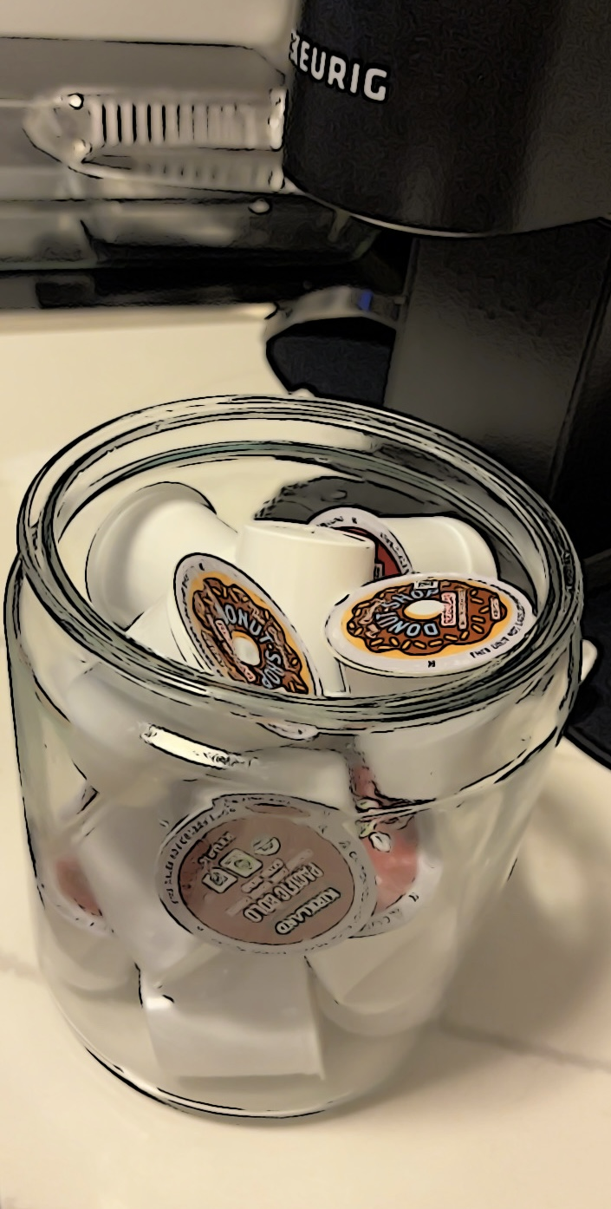
Plastic and convenience for me too… culpa communi sui generis apertus opus est reficiendum numquam desperare community guilt self-made obvious needs to be fixed never loose hope

Slide 52

THANK YOU. THOUGHTS? QUESTIONS?
Through others we become ourselves
                Lev Vygotsky 1896-1934

Slide 53
