Slide 1
The Climate Crisis and Mental Health: Expanding our Mental Health Model
Yale Seminar Series for Psychology Fellows, November 14, 2023
Elizabeth Allured, Psy.D., Clinical Psychologist
Co-founder, Climate Psychology Alliance – North America www.climatepsychology.us

Slide 2
“Quinnehtukqut”
The first First Nations reservation established in what would become the United States was located ten miles from my home, in 1638, near New Haven, Connecticut.
Photo: Wikipedia

Slide 3
The “Six Americas” reacting to Global Warming (Yale, 2022)

Slide 4
Uppalapatti et al, 2023

Slide 5
Study on Adolescent and Young Adult Reactions to Climate Crisis Inaction (Hickman et al, 2021) 10,000 participants, aged 16 – 25, in 10 countries (1,000 per country)
80% of this international sample felt “betrayed”
48% reported negative impacts on daily functioning (eating, sleeping, concentrating, school, work, relationships)
Levels of distress were higher in areas more affected by climate change
Over half felt anxious, powerless, sad, afraid, guilty, angry
Over 40% felt ashamed, depressed, grief, and hurt
56% felt “Humanity is doomed.”

Slide 6
More intergenerational differences
Tyson et al, 2021)

Slide 7
Question: What, if any, emotional/mental health impacts of the climate crisis have you or friends/family experienced?

Slide 8
A Better Definition: A Polycrisis or Hyperobject
Hyperobjects: Things that are massively distributed in time and space relative to humans (Morton, 2013)

Slide 9
A Polycrisis: The six intersecting environment-al crises
1. Rising greenhouse gases in atmosphere leading to global warming/climate disruption/extreme weather events
2. Deforestation for agriculture and profit, leading to less carbon storage, higher surface temperatures, and desertification
3. Fresh water depletion, with 40% of people experiencing water scarcity; this can lead to crop failure and mass migrations
4. Global soil degradation, from industrial agriculture, overuse of soils, overgrazing, erosion
5. Ocean acidification, as ocean absorbs 30% of CO2 from atmosphere; leads to diseased marine life, decreased human food supply
6. The Sixth Mass extinction, an ongoing loss of plant and animal life; insect pollenators for our food supply have been significantly declining

Slide 10
Clinical work with pre-traumatic climate distress (Van Susteren, 2021): facing the three terrors
Apocalyptic anxiety: anxiety requiring an “emotional dwelling with” each other to tolerate (Stolorow, 2021)
Annihilation anxiety: primitive fears of falling apart/loss of going-on-being (Winnicott, 1960; Hurvich, 1989)
Catastrophic thinking: appropriate at times (Kassouf, 2022)
anxiety: anxiety requiring an “emo

Slide 11
Mental Health Impacts of Global Warming, Chronic
Aggression/violence from warmer temperatures; interpersonal conflicts increase as temperatures rise
Lesser cognitive capacity during higher temperatures
Increases in average temperatures are related to increased use of emergency mental health services
Greater impacts on low-income communities
(Clayton et al, 2017)

Slide 12
Most susceptible to MH impacts of heat:
Homeless individuals
Those who work outdoors
The elderly
The very young
Those with schizophrenia showed the greatest death rate increase during a recent heat wave (Lee et al, 2023)

Slide 13
Drought, flooding, food insecurity
Severe weather events can have impacts on cognitive functioning due to malnutrition, school disruption, trauma regarding dislocation, relocation.

Slide 14
Mental health impacts of extreme weather events
Most common diagnosis: Acute Stress Disorder
Other common reactions:
Phobic disorders
Somatic symptoms
Depression
Alcohol and substance abuse
(Clayton et all, 2017, 2012;

Slide 15
Mental Health Impacts of Degrading/Degraded Environments
Depression
Anxiety
Suicidality
Grief
Solastalgia (loss of sense of place/community)
Loss of identity, connection with friends/family
Loss of autonomy and sense of control
Feelings of helplessness
Fatalism (Clayton et al, 2017; Randall, 2019)

Slide 16
“Climate Trauma” (Woodbury, 2022) from a dysfunctional relationship with our ecosystem
A “supraordinate trauma” generated by the disconnections related to “colonization, exploitation, racism, and the wounding of a living planet.” (Woodbury, 2019, 2022)
Some experience a “traumatized sensibility”
(Kassouf, 2022)

Slide 17
Types of Climate-Related Trauma: I. Pre-Traumatic (Anticipatory) Stress
Those not yet experiencing the direct impacts of climate-related events, yet feeling distress (anxiety, grief, anger, guilt, etc)
“Eco-grief”, “eco-anxiety”, “solastalgia”
Prior history of individual, transgenerational or communal trauma may increase likelihood of pre-traumatic stress and may heighten the response to it
Traumatic response to the climate emergency is NOT merely a displacement of earlier trauma.

Slide 18
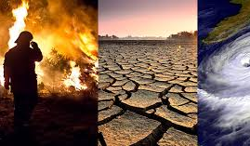
II. Post-traumatic/acute traumatic stress
Reaction to an extreme weather event or climate disruption (examples- hurricanes, floods, wildfires)
Acute stress or PTSD reactions
Need for Disaster Response with communities, trauma treatment for individuals, groups

Slide 19
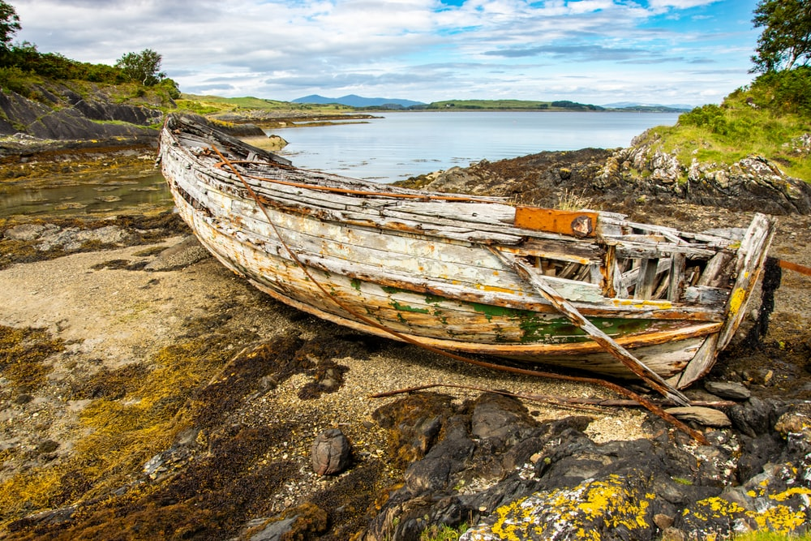
The Climate Crisis as Threat Multiplier: A Social Justice Issue
Existing inequities are magnified, including systemic racism, “petromasculinity” and transgenerational community trauma
Those contributing the least to the problem experience the most negative impacts:
BIPOC
Lower income
Elderly
Children
Undomiciled and undocumented
“We will be in the same storm but in different boats.”

Slide 20
Dr. Robert Bullard, Father of the Environmental Justice Movement
https://youtu.be/T_VjSGk8s18
Researched landfill placements in Black communities in the 1970’s
Drew connection between environmental racism and illness, death

Slide 21
What methods/formats have you used to process distressing climate information? What has been helpful/unhelpful?

Slide 22
Case example, An adolescent faces extreme weather distress
“It’s like, really scary. I’m really pissed, too—it’s YOU guys.”
Me: “You’re right, I’d be angry at people my age if I were you.”
“Like, nobody stopped it.”
Me: “Yes.”
Pause.
Me: “What are you afraid is going to happen?”

Slide 23
Learning from our adolescent clients, gaining new perspectives

Slide 24
Psychotherapeutic techniques
Exploring specific fears, future fears
Encouraging expression of affects
Working within the therapeutic dyad to allow new ways of interacting in vivo
Encouraging appropriate anger at the therapist as representing an inactive generation

Slide 25
Psychotherapeutic techniques, continued
Modeling an environmentally aware life stance
Allowing myself to be educated by the client
Helping the client “purpose” in the larger environment (Doppelt, 2016) to increase agency

Slide 26
Clinical treatment interventions currently in use for eco-distress (Baudon and Jachens, 2021)

Slide 27
1. Clinician’s inner work and education
Educating self regarding the problems, the solutions, the systems supporting problems and solutions
Processing one’s own feelings about these crises, one’s positionality, one’s place on the continuum of hopelessness to hopeful
Understand how one avoids/defends against the problems

Slide 28
2. Fostering clients’ inner resilience
3. Encouraging clients to take action
4. Helping clients find social connection and emotional support by joining groups
5. Connecting clients with nature
(Baudon and Jachens, 2021)

Slide 29
A “multiple needs framework” for treatment and interventions (Bingley et al, 2022)
Rather than measuring treatment success by lessening of emotional/behavioral symptoms alone, include a measure of environmental impacts also. (Seeing the environment as a factor in mental health, treating the whole problem)
A systems perspective, like family therapy

Slide 30
Question: What clinical challenges have come up for you regarding these issues?

Slide 31
A more encompassing mental health model
ANew Mental Health Model
Ecosystemic
Socio-political/cultural
Interpersonal
Intrapsychic

Slide 32
The American Psychological Association forms a Task force on the Climate Crisis and Mental Health

Slide 33
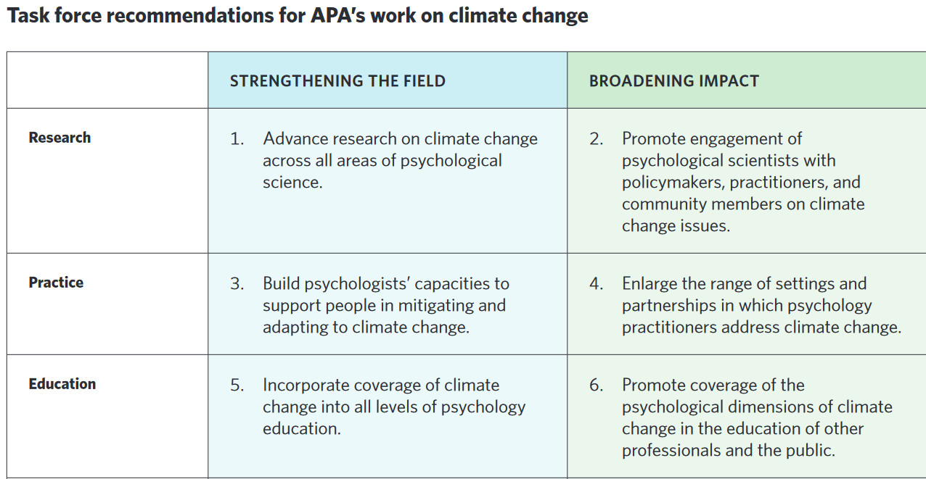

Slide 34
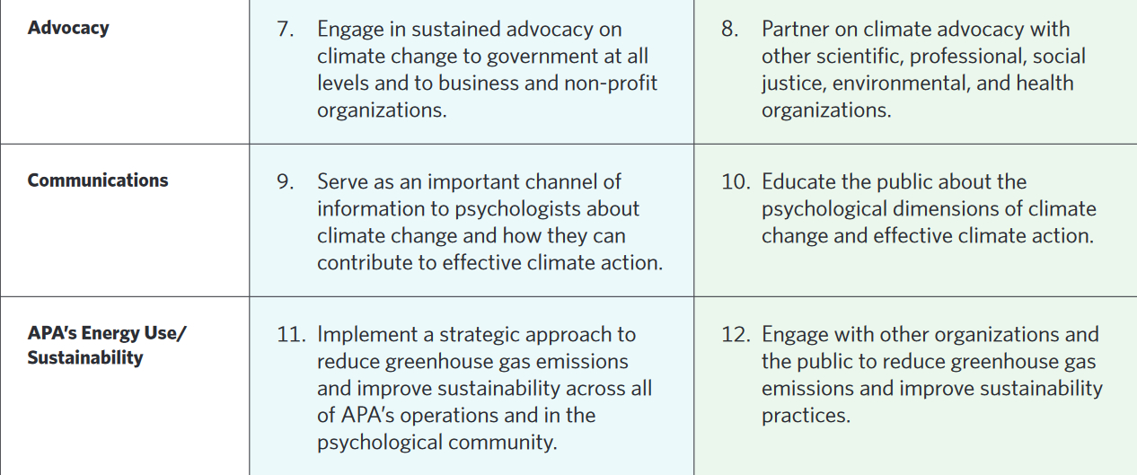

Slide 35
References
American Psychological Association, APA Task Force on Climate Change. (2022) Addressing the Climate Crisis: An Action Plan for Psychologists, Report of the APA Task Force on Climate Change. Retrieved from https://www.apa.org/science/about/publications/ climate-crisis-action-plan.pdf
Baudon, P. and Jachens, L. (2021). A scoping review of interventions for the treatment of eco-anxiety. Int. J. Environ. Res. Public Health, 18(18), 9636. https://www.mdpi.com/1660-4601/18/18/9636/htm
Bingley, W., Tran, A., Boyd, C., Gibson, K., Kalokerinos, E., Koval, P., Kashima, Y. McDonald, D., and Greenaway, K. (2022). A Multiple Needs Framework for Climate Change Anxiety Interventions. American Psychologist, Vol. 77, No. 7, 812-821.
Branas, C.. South, E., Kondo, M. and MacDonald, J. (2018).Citywide cluster randomized trial to restore blighted vacant land and its effects on violence, crime, and fear. PNAS, February 26, 2018. https://doi.org/10.1073/pnas.1718503115

Slide 36
References
Cianconi P, Betrò, S. and Janiri, L. (2020) The Impact of Climate Change on Mental Health: A Systematic Descriptive Review. Front. Psychiatry 11:74. doi: 10.3389/fpsyt.2020.00074
Clayton, S., Manning, C., Krygsman, K., and Speiser, M. (2017) Mental Health and Our Changing Climate: Impacts, Implications, and Guidance. Washington D.C.: American Psychological Association and ecoAmerica
Cornwall, W. (2023) Schizophrenia pinpointed as a key factor in heat deaths. Science, Vol. 379, Issue 6637, P. 1079. https://www.science.org/content/article/schizophrenia-pinpointed-key-factor-heat-deaths
Doppelt, B. (2016) Transformational Resilience: How Building Human Resilience to Climate Disruption Can Safeguard Society and Increase Wellbeing. NY: Routledge.
Hawken, P. (ed.) (2017) Drawdown: the most comprehensive plan ever proposed to reverse global warming. New York: Penguin Books.
Hawken, P. (2021) Regeneration: Ending the climate crisis in one generation. New York: Penguin Books.

Slide 37
References, Continued
Hickman, C., Marks, E., Pihkala, P., Clayton, S., Lewandowski, E., Mayall, E., Wray, B., Mellor, C., Van Susteren, L. (2021) Young people’s voices on climate anxiety, government betrayal and moral injury: a global phenomenon. The Lancet, Volume 5, Issue 12, E863-E873. https://www.thelancet.com/journals/lanplh/article/PIIS2542-5196(21)00278-3/fulltext
Kassouf, S. (2022). Thinking catastrophic thoughts: A traumatized sensibility on a hotter planet. The American Journal of Psychoanalysis, https://doi.org/10.1057/s11231-022-09340-3
Lee, M. J., McLean, K. E., Kuo, M., Richardson, G. R. A., & Henderson, S. B. (2023). Chronic diseases associated with mortality in British Columbia, Canada during the 2021 western North America extreme heat event. GeoHealth, 7, e2022GH000729. https://doi.org/10.1029/2022GH000729

Slide 38
References
ISBN-13 ‏ : ‎ 979-8449752147
ISBN-13 ‏ : ‎ 979-8449752147
ISBN-13 ‏ : ‎ 979-8449752147
Morton, T. (2013) Hyperobjects: Philosophy and Ecology after the End of the World. Minneapolis, MN: University of Minnesota Press.
Tyson, A., Kennedy, B. and Funk, C. (2021) Gen Z, Millennials Stand Out for Climate Change Activism, Social Media Engagement With Issue. Pew Research Center https://www.pewresearch.org/short-reads/2021/05/26/key-findings-how-americans-attitudes-about-climate-change-differ-by-generation-party-and-other-factors/
Uppalapati, S., Ballew, M., Campbell, E., Kotcher, J., Rosenthal, S., Leiserowitz, A., & Maibach, E. (2023). The prevalence of Climate Change Psychological Distress among American adults. Yale University and George Mason University. New Haven, CT: Yale Program on Climate Change Communication.

Slide 39
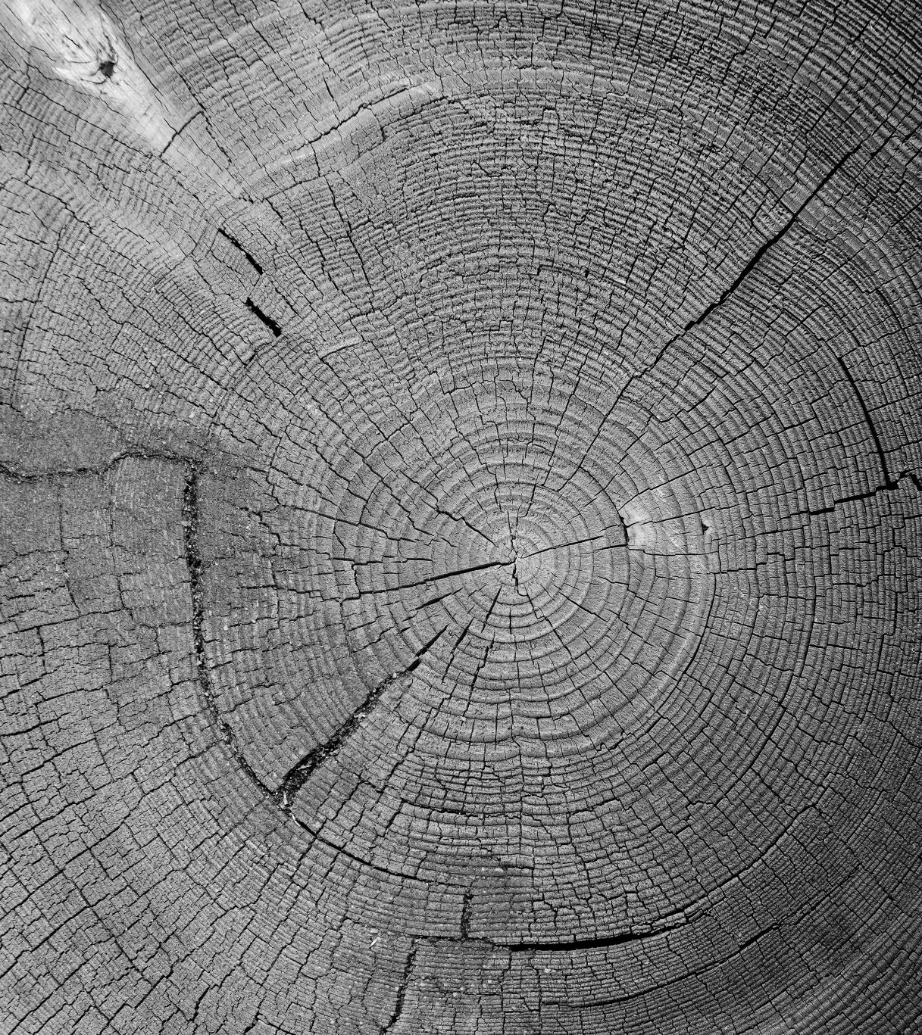
References, Continued
Van Susteren, L. (2021) Editorial Perspective: A Parable for Climate Collapse? Child and Adolescent Mental Health, 26, NO. 3, 2021, pp. 269-271.
Woodbury, Z. (2022) Climate Trauma, Reconciliation, and Recovery: Coming into Proper Relationship with Mother Earth. Self-published. ISBN-13: 979-8449752147
Yale Program on Climate Change Communication (2022) https://climatecommunication.yale.edu/about/projects/global-warmings-six-americas/

